Slide 1
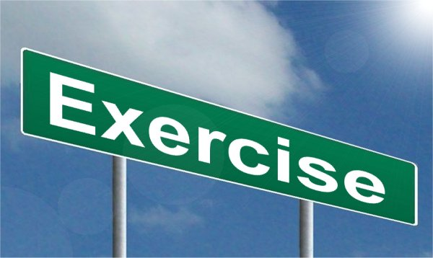
Virtual Challenges
Welcome to Clixby Active Pro Sports ‘Virtual Challenges’.
I will show you 12 different challenges.
You’ll be working with/against a partner!
The main thing is to try your personal best.
Have fun!

Slide 2
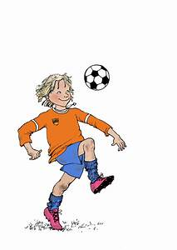
Challenge 1:
Football Keepie Uppies
Homeschooling Daily Challenges – Clixby Active Pro Sports Ltd
Try to do as many as you can in the 60 second time limit.
Equipment needed:
1 football

Slide 3
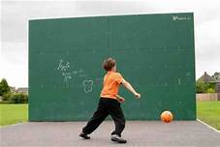
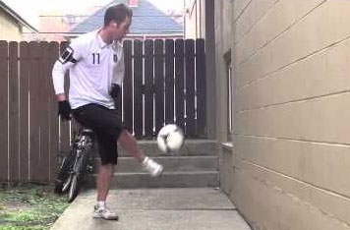
Challenge 2:
Football Wall Passes
Homeschooling Daily Challenges – Clixby Active Pro Sports Ltd
Try to do as many as you can in the 60 second time limit.
Equipment needed:
1 football & a wall

Slide 4
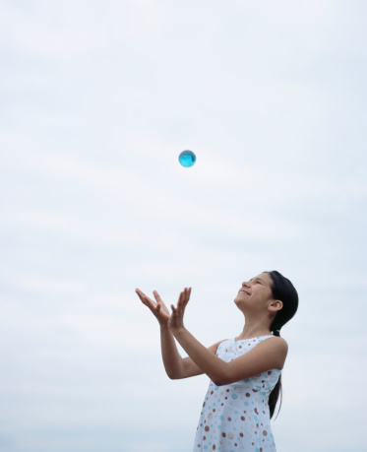
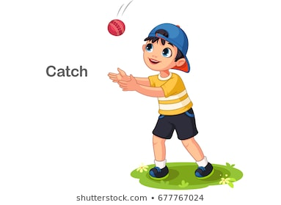
Challenge 3:
Catching
Homeschooling Daily Challenges – Clixby Active Pro Sports Ltd
Try to do as many as you can in the 60 second time limit.
Equipment needed:
1 tennis ball

Slide 5
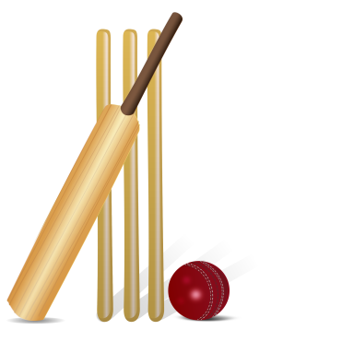
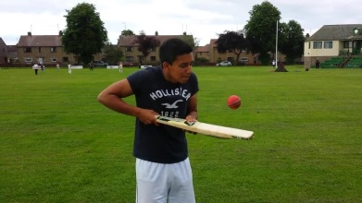
Challenge 4:
Bat Keepie Uppies
Homeschooling Daily Challenges – Clixby Active Pro Sports Ltd
Try to do as many as you can in the 60 second time limit.
Equipment needed:
1 cricket bat & 1 tennis ball

Slide 6
Challenge 5:
Throwing
Homeschooling Daily Challenges – Clixby Active Pro Sports Ltd
Try to do as many as you can in the 60 second time limit.
Equipment needed:
1 tennis ball, 3 markers, 1 set of wickets

Slide 7
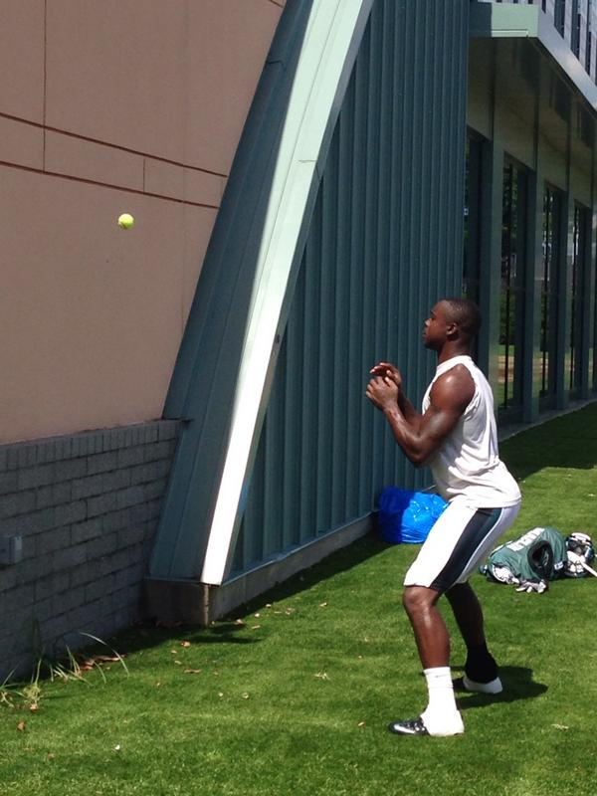
Challenge 6:
Wall Catching
Homeschooling Daily Challenges – Clixby Active Pro Sports Ltd
Try to do as many as you can in the 60 second time limit.
Equipment needed:
1 tennis ball & a wall

Slide 8
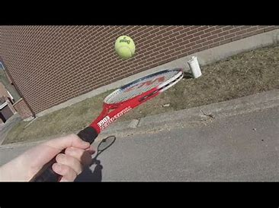
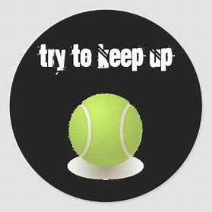
Challenge 7:
Tennis Keepie Uppies
Homeschooling Daily Challenges – Clixby Active Pro Sports Ltd
Try to do as many as you can in the 60 second time limit.
Equipment needed:
1 tennis racket & 1 tennis ball

Slide 9
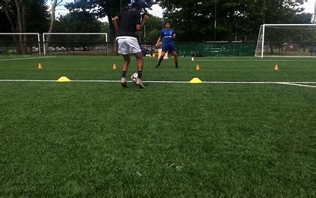
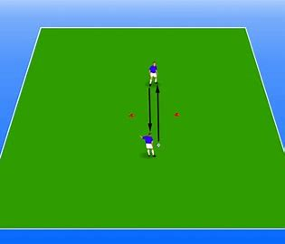
Challenge 8:
Partner Passing
Homeschooling Daily Challenges – Clixby Active Pro Sports Ltd
Try to do as many as you can in the 60 second time limit.
You need to work with your partner on this challenge.
Equipment needed:
1 football & 2 dish cones

Slide 10
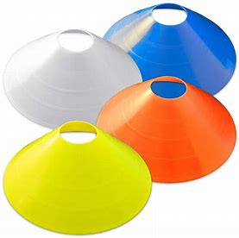
Challenge 9:
Partner Cone Catching
Homeschooling Daily Challenges – Clixby Active Pro Sports Ltd
Try to do as many as you can in the 60 second time limit.
You need to work with your partner on this challenge.
Equipment needed:
1 tennis ball & 1 dish cone

Slide 11
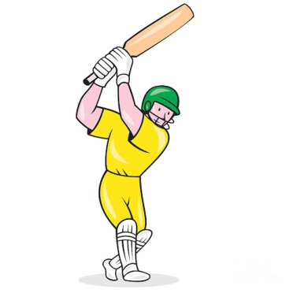
Challenge 10:
Bat Dribbling
Homeschooling Daily Challenges – Clixby Active Pro Sports Ltd
Try to do as many as you can in the 60 second time limit.
Equipment needed:
1 cricket bat & 5 cones

Slide 12
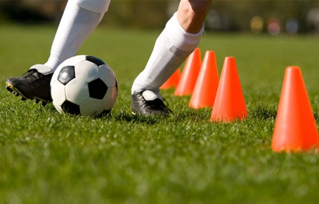
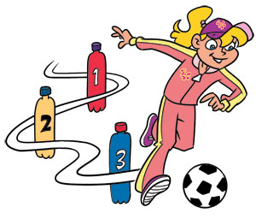
Challenge 11:
Football Dribbling
Homeschooling Daily Challenges – Clixby Active Pro Sports Ltd
Try to do as many as you can in the 60 second time limit.
Equipment needed:
1 football & 5 cones

Slide 13
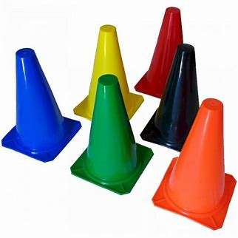
Challenge 12:
Knock Down
Homeschooling Daily Challenges – Clixby Active Pro Sports Ltd
Try to do as many as you can in the 60 second time limit.
Equipment needed:
1 football & 15 cones

Slide 14
GOOD LUCK!
Football Keepie Uppies
Football Wall Passes
Catching
Bat Keepie Uppies
Throwing
Wall Catching
Tennis Keepie Uppies
Partner Passing
Partner Cone Catching
Bat Dribbling
Football Dribbling
Knock Down
Try to do as many as you can in the 60 second time limit.
For partner cone catching and partner passing challenges you work with your partner for both goes.
For all other challenges your aim is to try and beat your partner’s score!

