Slide 1

Sports Quiz

Slide 2

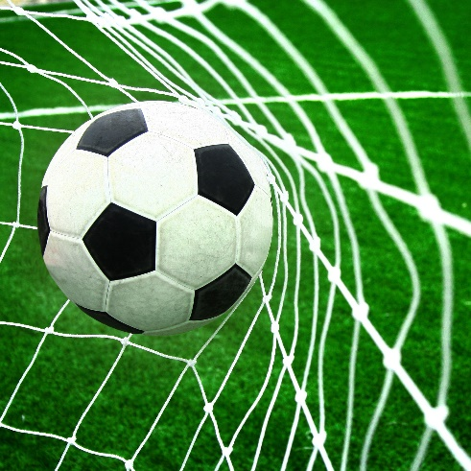
Question 1:
How many players are there in a Professional football side?

Slide 3
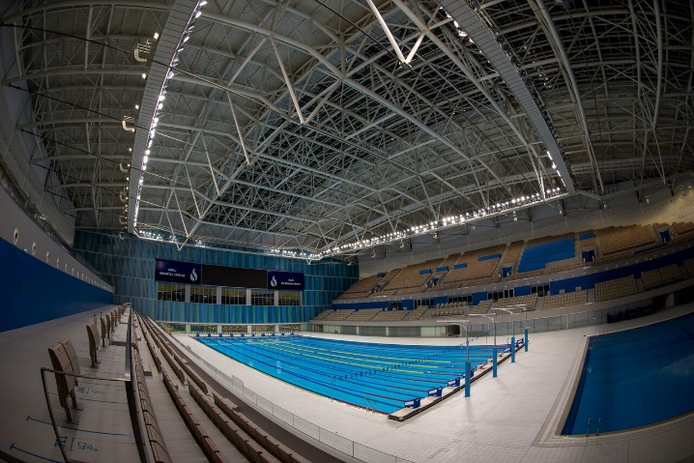
Question 2:
An Olympic-size swimming pool is how many metres long?

Slide 4
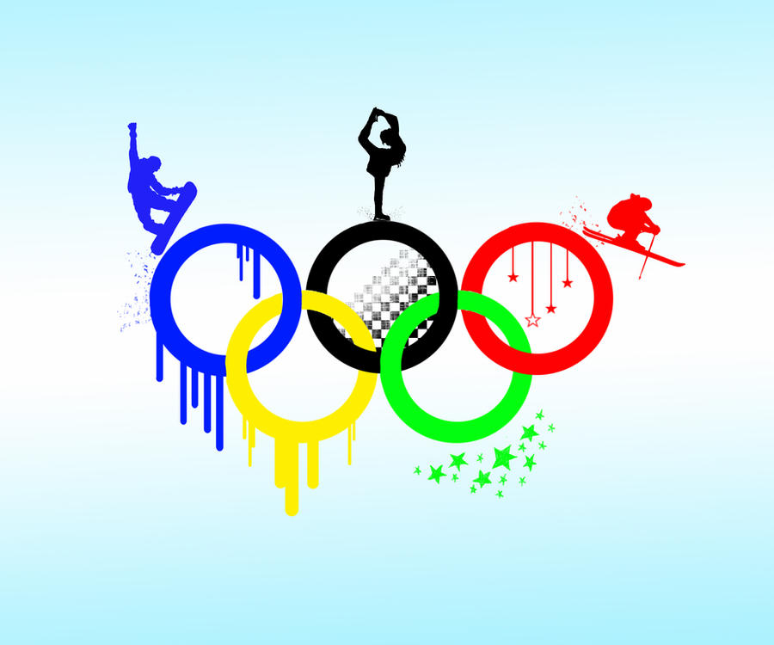
Question 3:
Which country has won the most medals in total at the Winter Olympic Games?

Slide 5
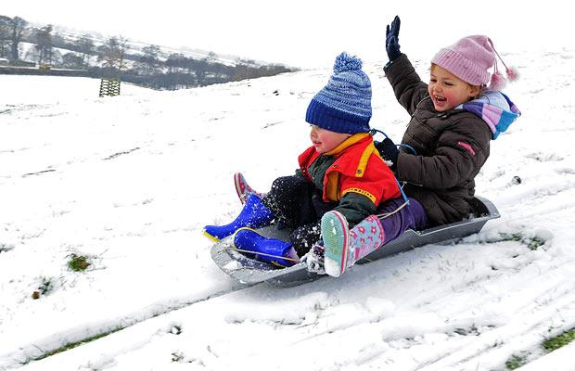
Question 4:
Name the two-or-four-person team event in the Winter Olympics that involves racing a specially designed sled down an ice track?

Slide 6
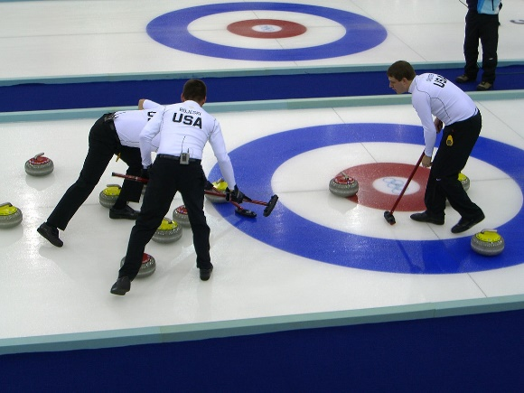
Question 5:
In which sport do two teams play each other on ice and sweep stones towards a target?

Slide 7

Question 6:
How many athletic throwing events are there?

Slide 8
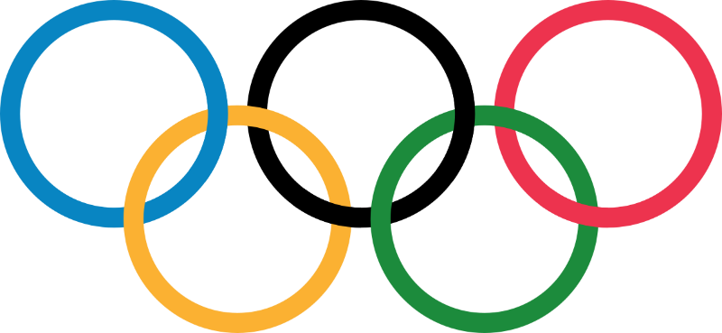
Question 7:
The 2020 Summer Olympics should have been held in which City?

Slide 9

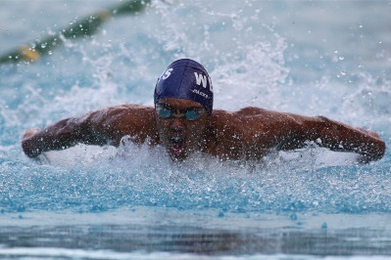
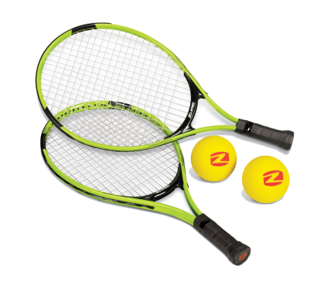
Question 8:
Is Michael Phelps a champion at:
  Athletics?
  Football?
  Swimming?
  Or Tennis?

Slide 10

Question 9:
Out of all the Summer Olympic sports which sport comes first alphabetically?

Slide 11

Question 10:
Which city hosted the Summer Olympics in 1908, 1948 & 2012?

Slide 12
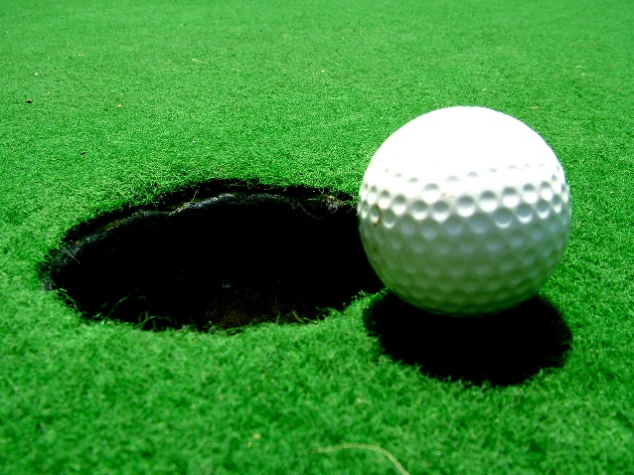
Question 11:
What does the term ‘birdie’ mean in a game of golf?

Slide 13

Question 12:
Which flag is waved in motor racing to show the winner?

Slide 14
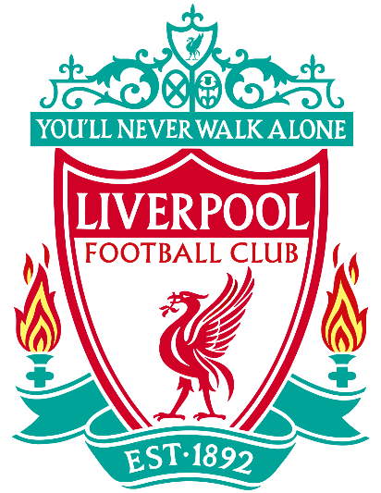
Question 13:
In which football stadium do Liverpool play all their home matches?

Slide 15
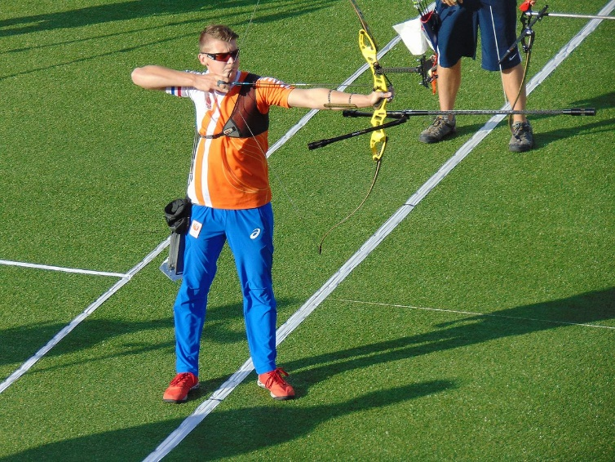
Question 14:
What colour is the centre of the target in archery?

Slide 16
Question 15:
Which country invented Volleyball?

Slide 17
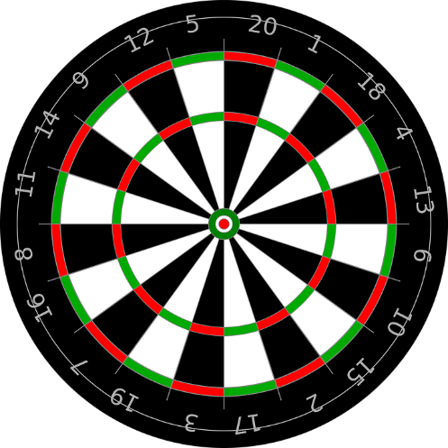
Question 16:
In a game of darts, what is the highest possible score using three darts?

Slide 18

Question 17:
What type of race is the Tour de France?

Slide 19
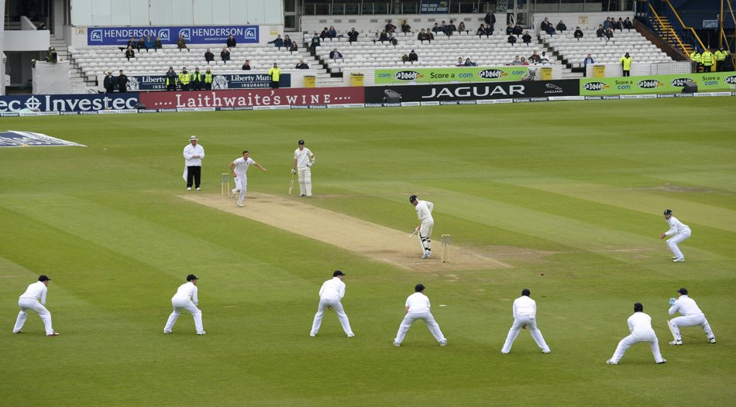
Question 18:
How many players are there in a cricket team (on the field at any one time)?

Slide 20
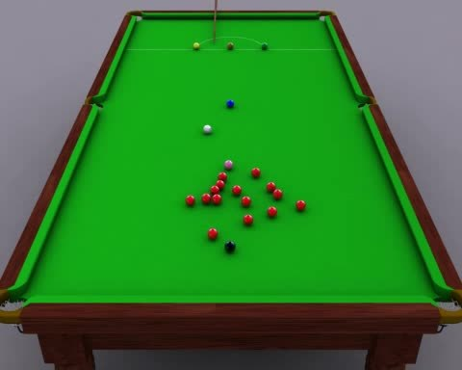
Question 19:
What colour balls are worth six points in a game of snooker?

Slide 21

Question 20:
What city hosts the Wimbledon Tennis Championships?

Slide 22

Question 21:
Which three sports form a triathlon?

Slide 23
Question 22:
Which sport uses the lightest ball?

Slide 24
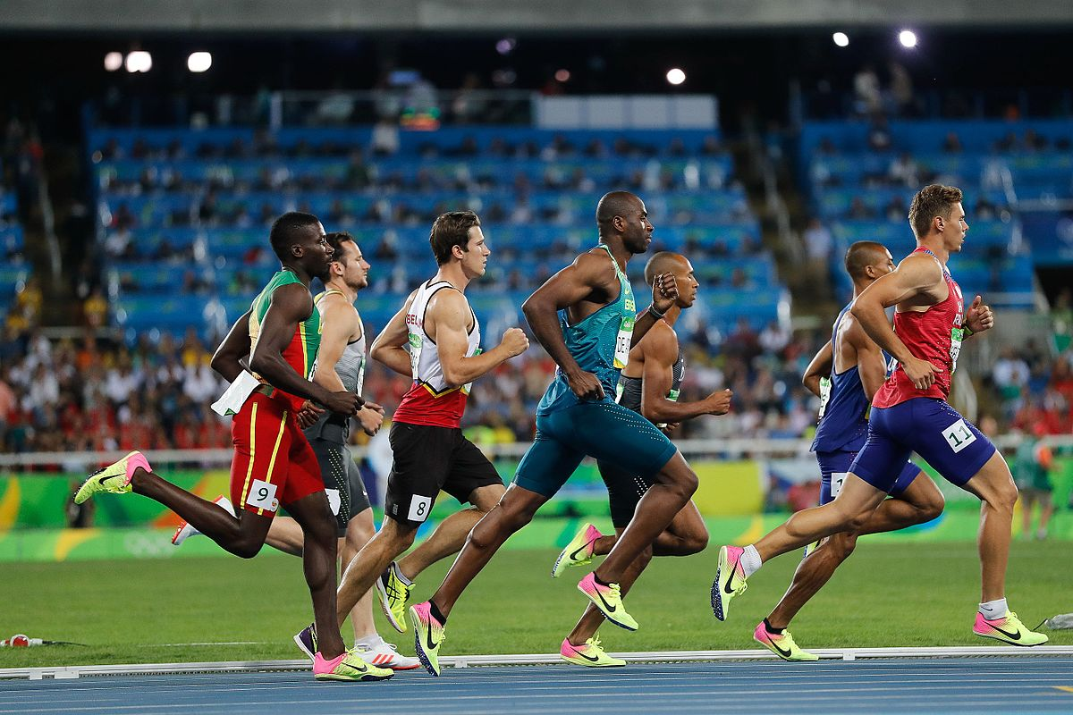
Question 23:
How many athletic events form a decathlon?

Slide 25
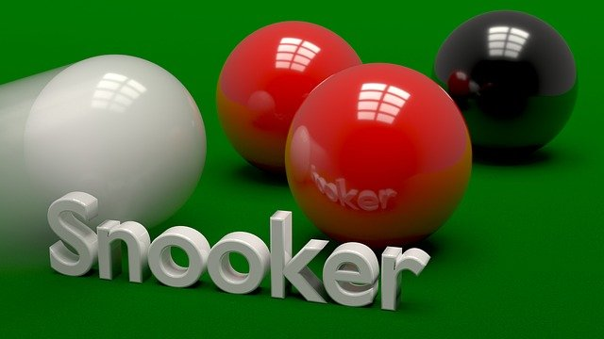
Question 24:
How many pockets are there on a snooker table?

Slide 26
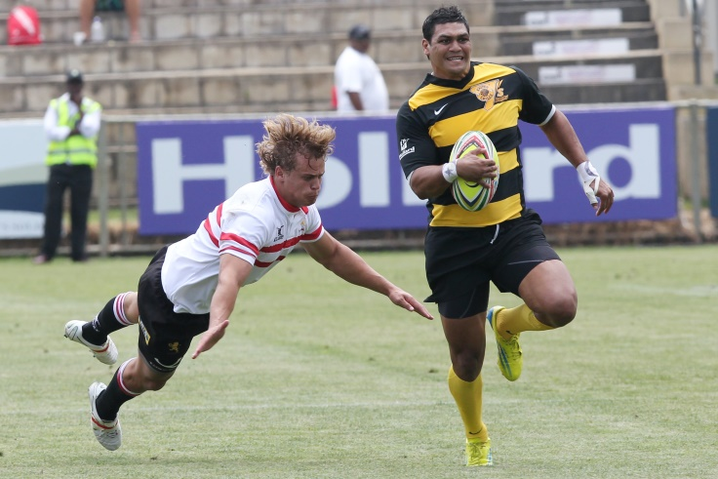
Question 25:
How many players are there in a rugby league team?

Slide 27

Question 26:
What type of sport is played on horseback

Slide 28
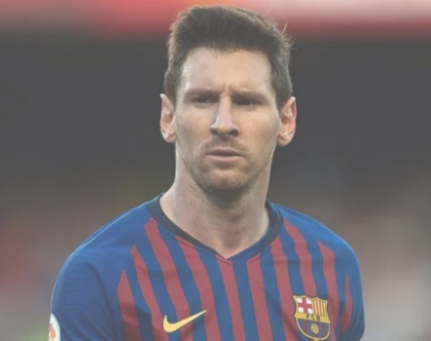
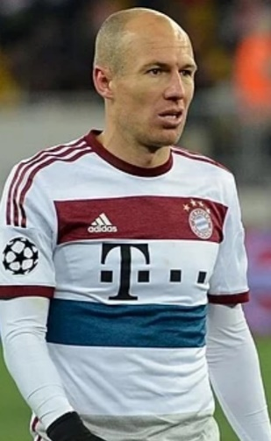
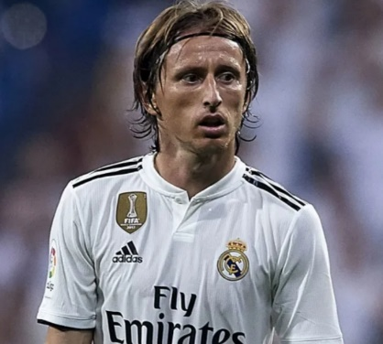
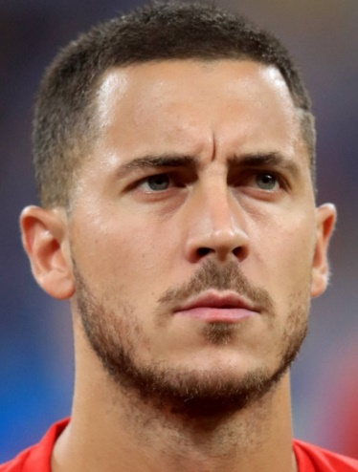
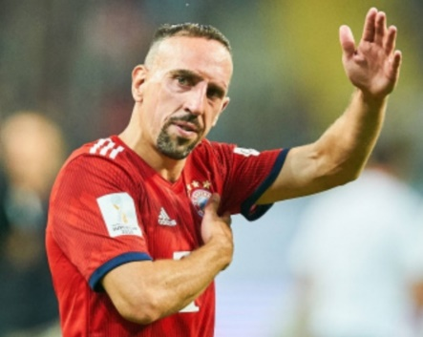
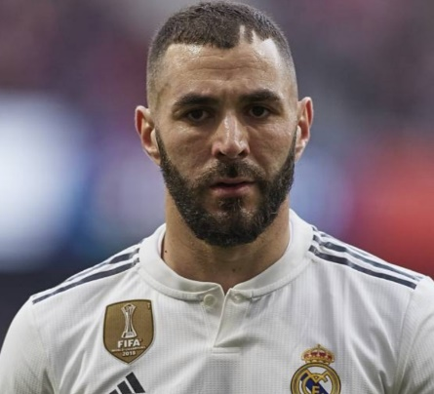
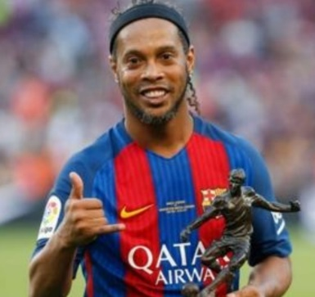
Questions 27-33:
Name the footballers:
27
28
29
30
31
32
33

Slide 29

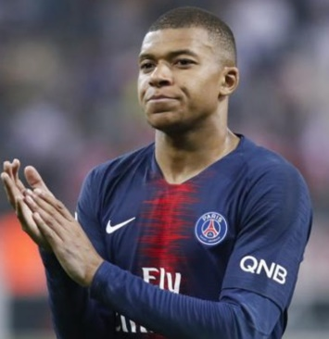
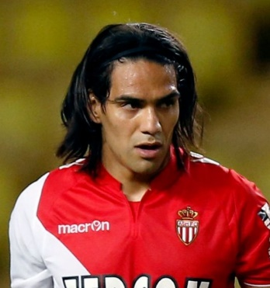
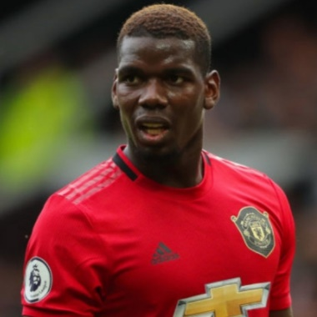
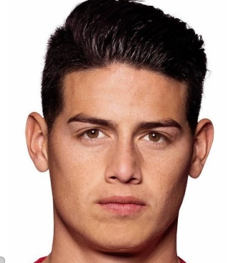
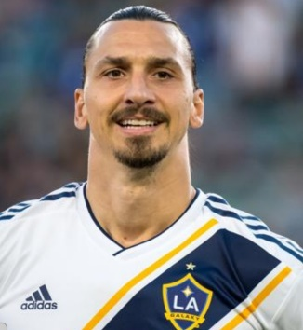
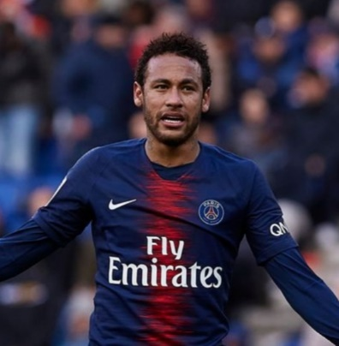
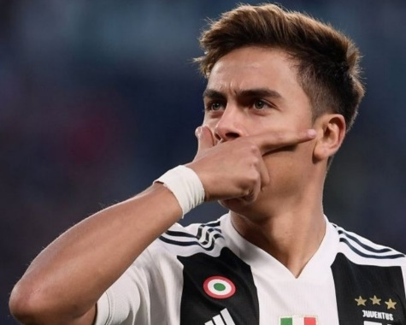
Questions 34-40:
Name the footballers:
34
35
36
37
39
40
38

Slide 30

ANSWERS:
11
50m
Norway
Bobsleigh
Curling
4 (Shot, Discus, Javelin, hammer)
Tokoyo
Swimming
Archery
London

Slide 31
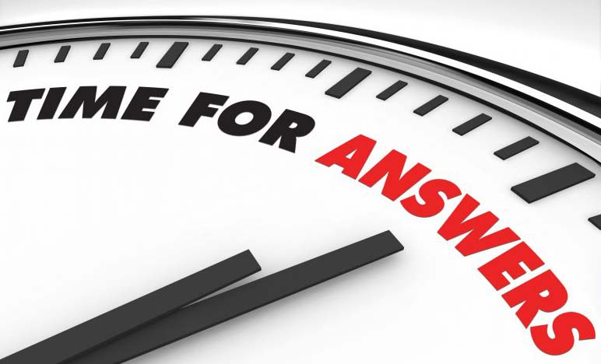
ANSWERS:
11. 1 under par
12. Chequered flag
13. Anfield
14. Red
15. USA
16. 180
17. Cycling
18. 11
19. Pink ball
20. London

Slide 32
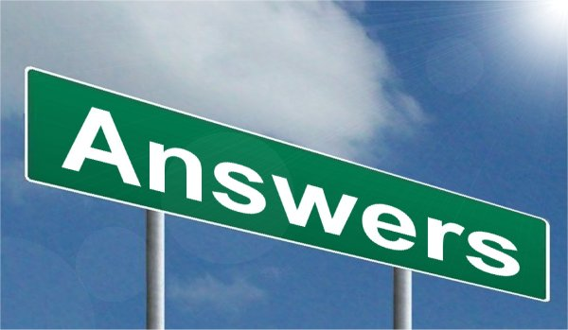
ANSWERS:
21. Swimming, Cycling & Running
22. Table tennis
23. 10
24. 6
13
Polo
Lionel Messi
Arjen Robben
Luka Modric
Eden Hazard

Slide 33
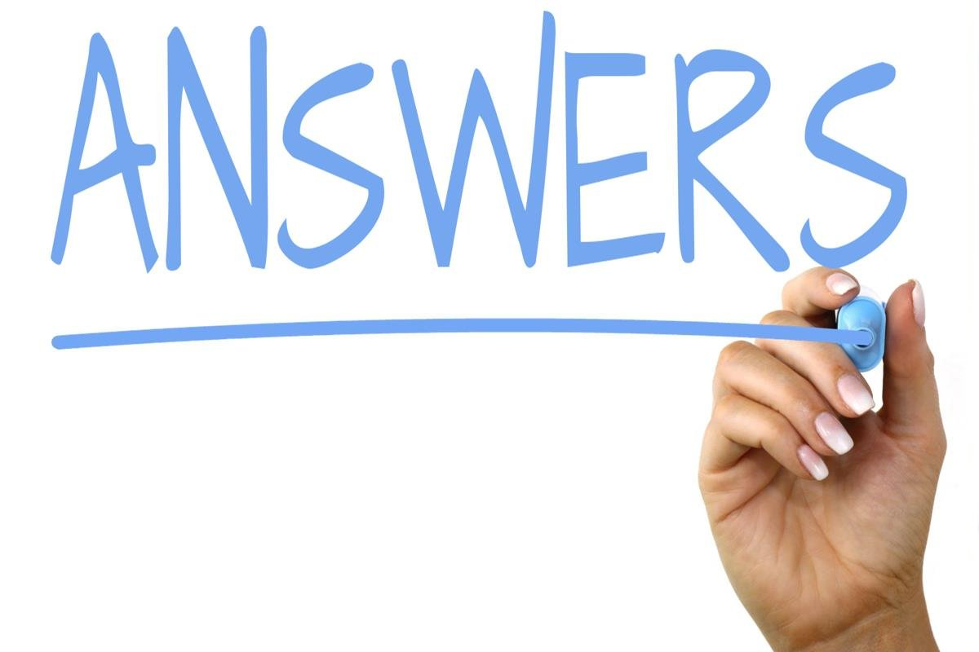
ANSWERS:
31. Frank Ribery
Karim Benzema
Ronaldinho
Kylian Mbappe
Radamel Falcao
Paul Pogba
James Rodriguez
Zlatan Ibrahimovic
Neymar
Paulo Dybala

Slide 34



How did you do?
How many correct answers did you achieve?
The maximum score is 40.
Work out your percentage:
Score divided by 40 = ??%
E.g. 20 / 40 = 50%
WELL DONE EVERYONE!

