Slide 1
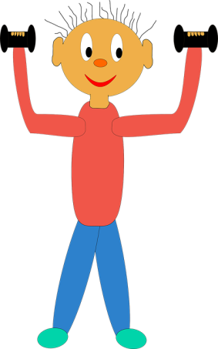
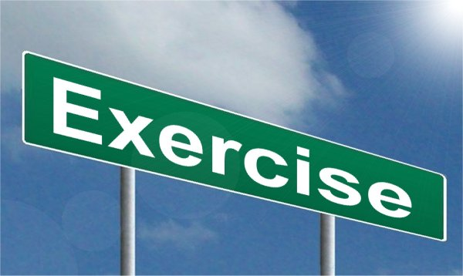
Virtual Workout
Welcome to Clixby Active Pro Sports ‘Virtual Workout’.
Do each exercise for 35 seconds and then have a 25 second rest!
Follow the Body Coaches’ YouTube video links.
If you want to be competitive then get a partner to count how many you complete in the 35 seconds and then try to beat each other!
The main thing is to try your personal best.
Have fun!

Slide 2
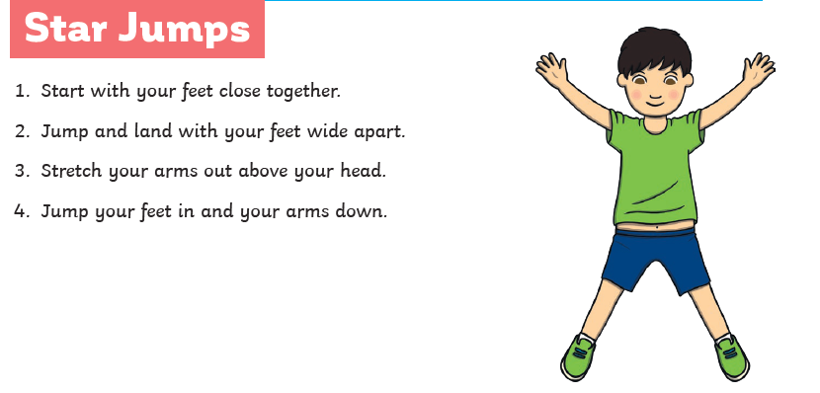
Exercise 1:
https://www.youtube.com/watch?v=rN0h6EZd6TM
Try to do as many as you can in the 35 second time limit.
Then have a well earned 25 second rest!

Slide 3
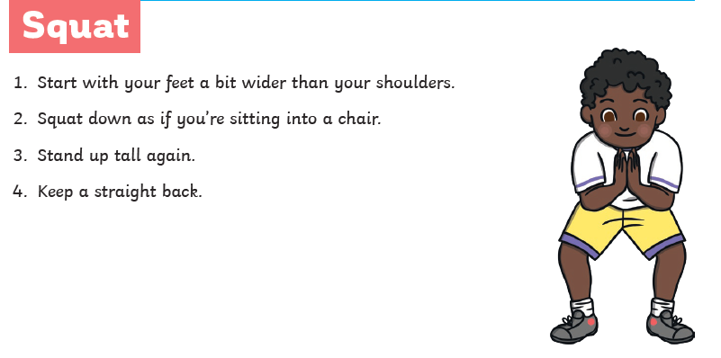
Exercise 2:
https://www.youtube.com/watch?v=rN0h6EZd6TM : 1:05
Try to do as many as you can in the 35 second time limit.
Then have a well earned 25 second rest!

Slide 4
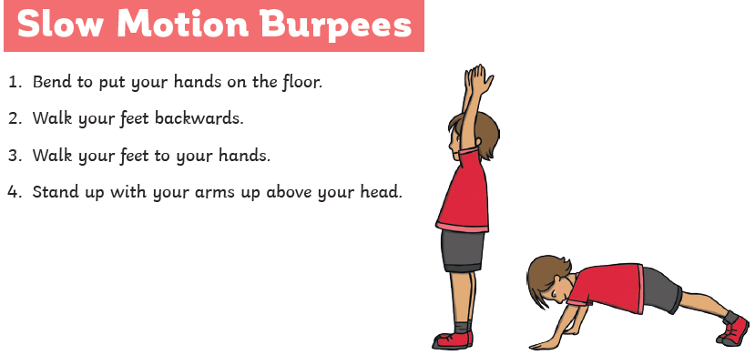
Exercise 3:
https://www.youtube.com/watch?v=rN0h6EZd6TM: 2:15
Try to do as many as you can in the 35 second time limit.
Then have a well earned 25 second rest!

Slide 5
Exercise 4:
https://www.youtube.com/watch?v=rN0h6EZd6TM: 3:06
Try to do as many as you can in the 35 second time limit.
Then have a well earned 25 second rest!

Slide 6
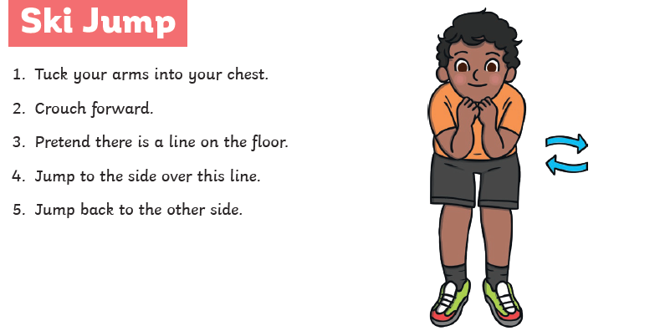
Exercise 5:
https://www.youtube.com/watch?v=rN0h6EZd6TM: 4:05
Try to do as many as you can in the 35 second time limit.
Then have a well earned 25 second rest!

Slide 7
Exercise 6:
https://www.youtube.com/watch?app=desktop&v=pnKCGY9ZocA&list=PLLpBgP_pUsadPsJ4ebXj5WFyxhEhrBP7r&index=5&t=0s
Try to do as many as you can in the 35 second time limit.
Then have a well earned 25 second rest!

Slide 8
Exercise 7:
https://www.youtube.com/watch?app=desktop&v=pnKCGY9ZocA&list=PLLpBgP_pUsadPsJ4ebXj5WFyxhEhrBP7r&index=5&t=0s: 1:24
Try to do as many as you can in the 35 second time limit.
Then have a well earned 25 second rest!

Slide 9
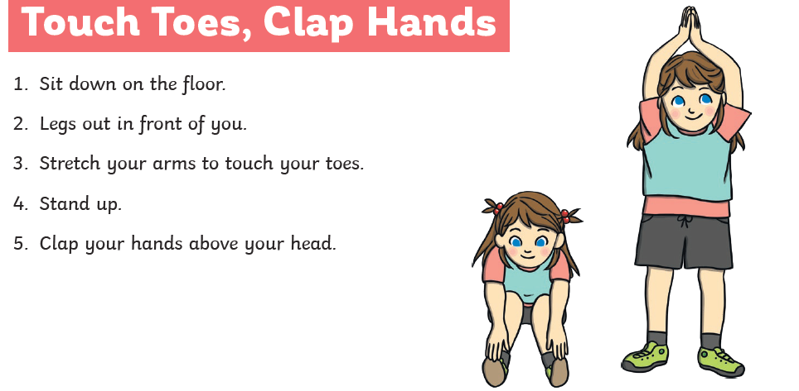
Exercise 8:
https://www.youtube.com/watch?app=desktop&v=pnKCGY9ZocA&list=PLLpBgP_pUsadPsJ4ebXj5WFyxhEhrBP7r&index=5&t=0s: 2:30
Try to do as many as you can in the 45 second time limit.
Then have a well earned 25 second rest!

Slide 10
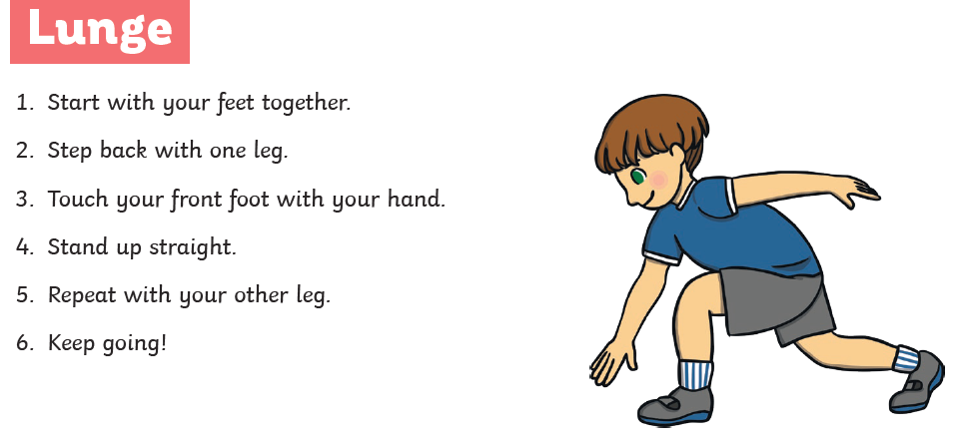
Exercise 9:
https://www.youtube.com/watch?app=desktop&v=pnKCGY9ZocA&list=PLLpBgP_pUsadPsJ4ebXj5WFyxhEhrBP7r&index=5&t=0s: 2:30
Try to do as many as you can in the 35 second time limit.
Then have a well earned 25 second rest!

Slide 11
Exercise 10:
https://www.youtube.com/watch?app=desktop&v=pnKCGY9ZocA&list=PLLpBgP_pUsadPsJ4ebXj5WFyxhEhrBP7r&index=5&t=0s: 4:27
Try to do as many as you can in the 35 second time limit.
Then have a well earned 25 second rest!

