Slide 1

Sports Quiz

Slide 2

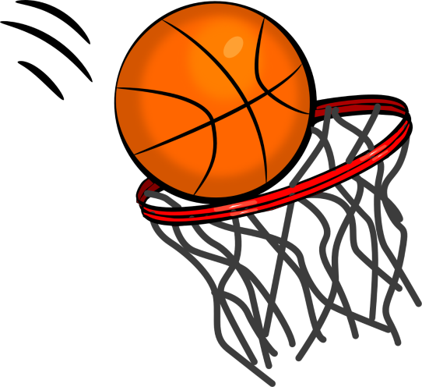
Question 1:
How many players are there in a basketball side?

Slide 3
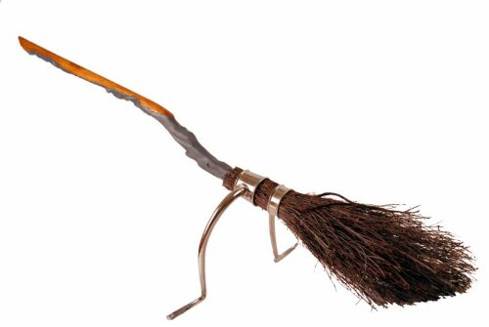
Question 2:
Which wizarding sport played on broomsticks does Harry Potter play?

Slide 4
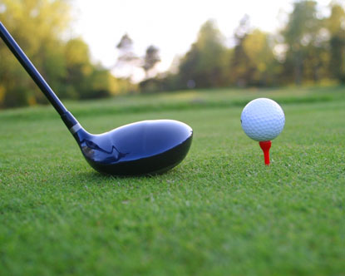
Question 3:
Name the golfer who’s first name is the same as a big cat?

Slide 5

Question 4:
Which country does the footballer Lionel Messi play for?

Slide 6

Question 5:
How many rings are there on the Olympic flag?

Slide 7

Question 6:
Which sport did Johnny Wilkinson and Martin Johnson play?

Slide 8
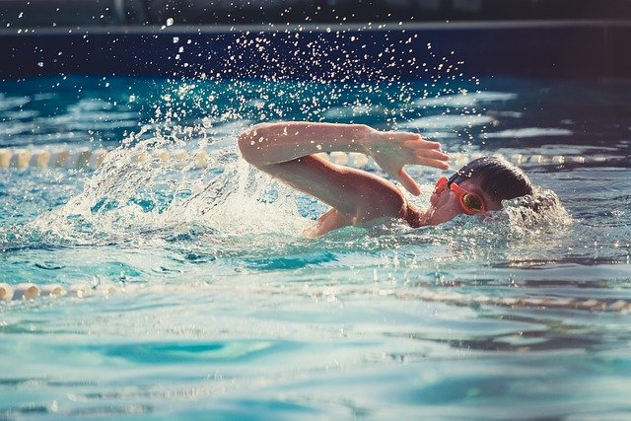
Question 7:
Which type of swimming stroke has the same name as a flying insect?

Slide 9

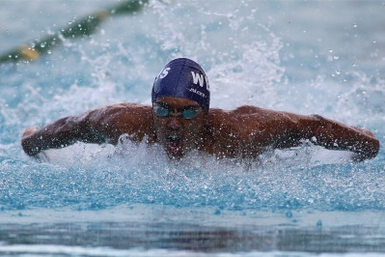
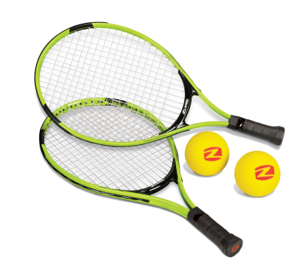
Question 8:
Is Mo Farah a champion at:
  Athletics?
  Football?
  Swimming?
  Or Tennis?

Slide 10
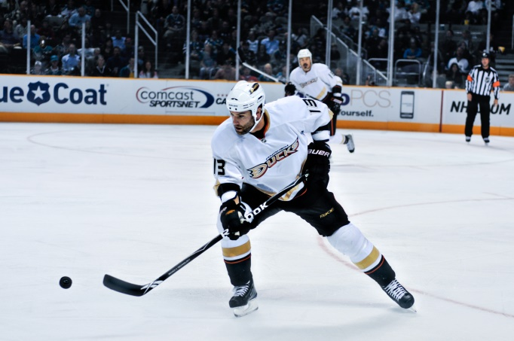
Question 9:
What is the name of the hard rubber disc players hit in ice hockey?

Slide 11

Question 10:
A caddy is the person who carries a player’s bag in which sport?

Slide 12
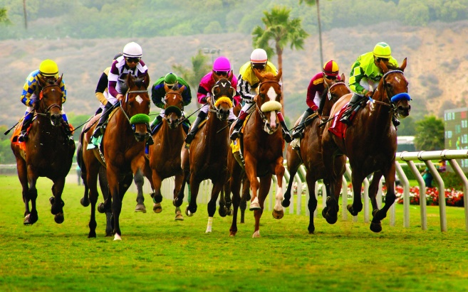
Question 11:
Which important horse race is jumped over fences at Aintree and was once won by Red Rum?

Slide 13

Question 12:
How many goals are scored if a player has a hat-trick?

Slide 14
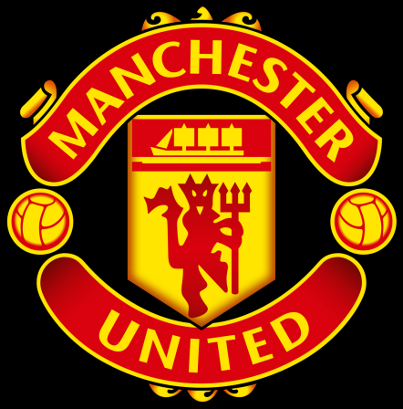
Question 13:
In which football stadium do Manchester United play all their home matches?

Slide 15
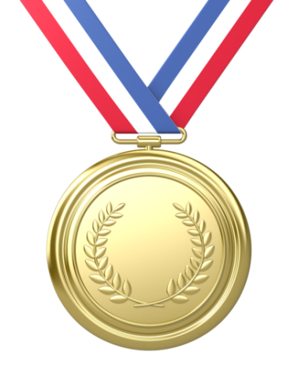
Question 14:
In the Olympics you get a gold medal for coming first, what do you get for coming second and third (two answers)?

Slide 16
Question 15:
In which country did the Olympic games originate?

Slide 17

Question 16:
Andy Murray is a champion in which sport?

Slide 18
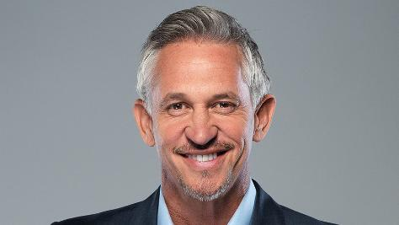
Question 17:
What sort of snack food does former footballer Gary Lineker advertise on TV?

Slide 19

Question 18:
What do teams pull in a game of tug of war?

Slide 20
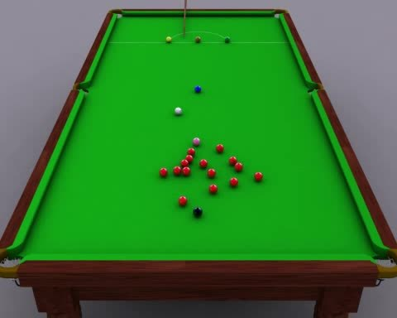
Question 19:
What colour balls are worth one point in a game of snooker?

Slide 21
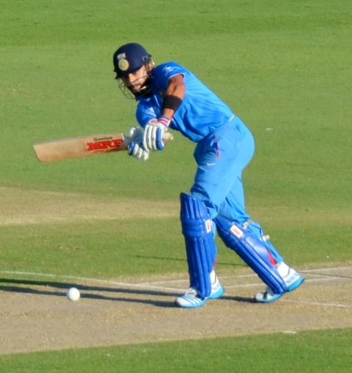
Question 20:
How many vertical wooden stumps make up a cricket wicket?

Slide 22
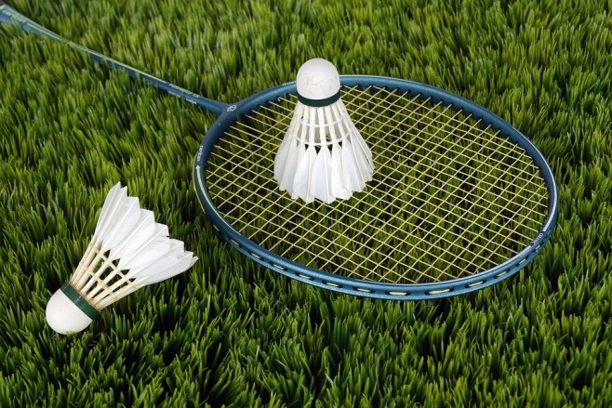
Question 21:
What do players hit in the game badminton?

Slide 23

Question 22:
What name is given to the spear like object thrown in athletics at the Olympics?

Slide 24
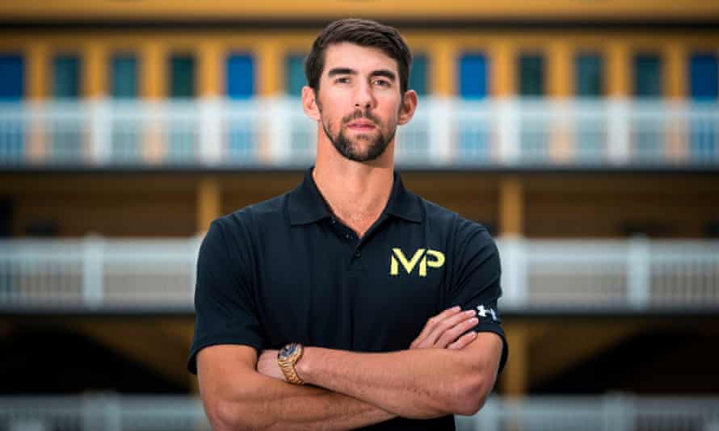
Question 23:
Michael Phelps has won the most Olympic medals ever; which sport did he compete in?

Slide 25
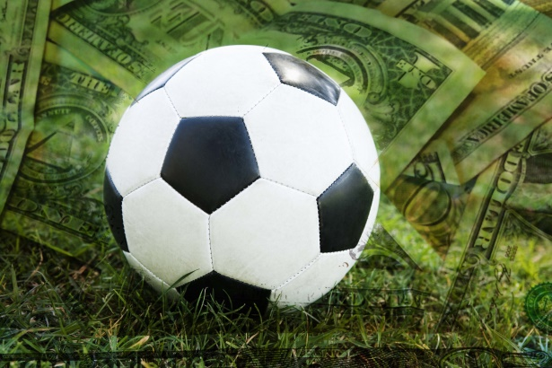
Question 24:
Which football team are also called The Gunners?

Slide 26
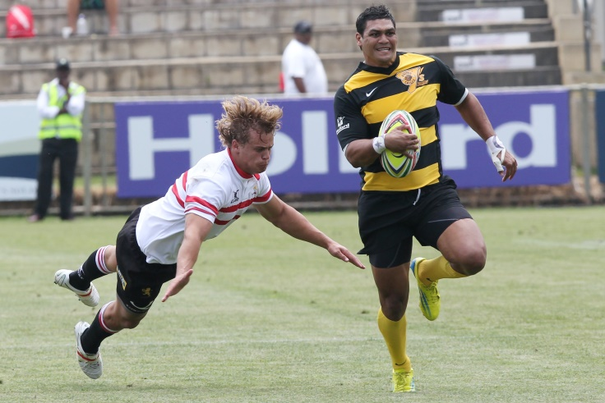
Question 25:
How many points does a player get for a try in rugby?

Slide 27

Question 26:
In which sport might you hear the score announced as ‘30-love’?

Slide 28

Question 27:
In which sport can you get ‘a hole in one’?

Slide 29
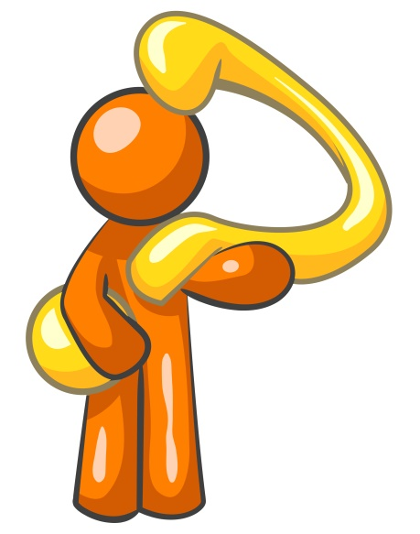
Question 28:
Which sport is also known as ping pong?

Slide 30

Question 29:
In which athletics event is a long stick used to jump over a high bar?

Slide 31
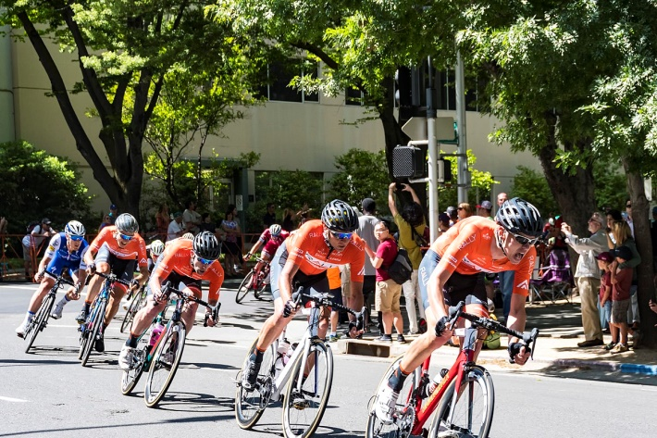
Question 30:
Which colour jersey does the leader in the Tour de France cycle race wear?

Slide 32

ANSWERS:
Five
Quiditch
Tiger Woods
Argentina
Five
Rugby Union
Butterfly
Athletics
Puck
Golf

Slide 33

ANSWERS:
11. The Grand National
12. Three
13. Old Trafford
14. Silver (2nd) and Bronze (3rd)
15. Greece
16. Tennis
17. Crisps
18. A long rope
19. Red balls
20. Three

Slide 34
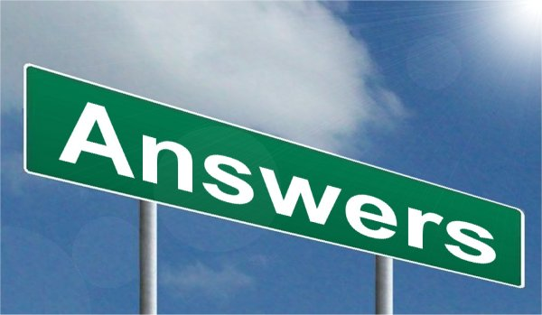
ANSWERS:
21. Shuttlecock
22. Javelin
23. Swimming
24. Arsenal
Five
Tennis – ‘love’ means zero points
Golf
Table Tennis
Pole Vault
Yellow

Slide 35


How did you do?
How many correct answers did you achieve?
The maximum score is 31.
Work out your percentage:
Score divided by 31 = ??%
E.g. 20 / 31 = 65%
WELL DONE EVERYONE!

