Slide 1

Sports Quiz

Slide 2

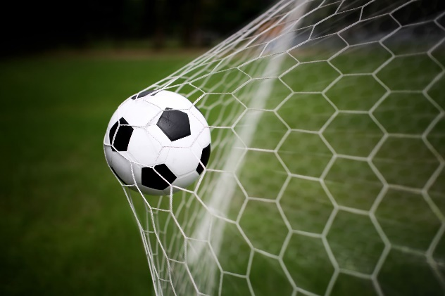
Question 1:
How many players are there in a professional football team?

Slide 3
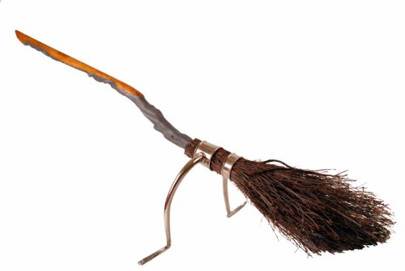
Question 2:
Which wizarding sport played on broomsticks does Harry Potter play?

Slide 4
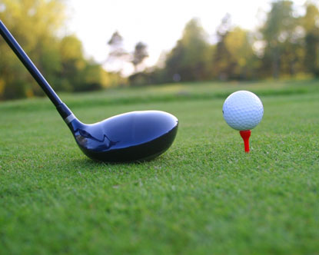
Question 3:
What sport is being played here?

Slide 5

Question 4:
Which country does the footballer Lionel Messi play for?

Slide 6

Question 5:
How many rings are there on the Olympic flag?

Slide 7
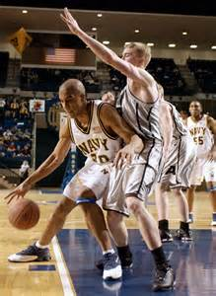
Question 6:
Which sport is being played here?

Slide 8
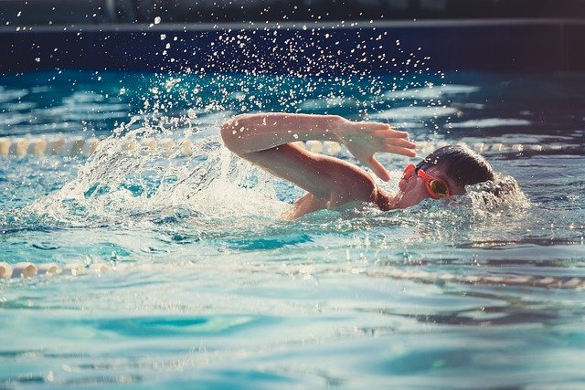
Question 7:
Which type of swimming stroke has the same name as a flying insect?

Slide 9

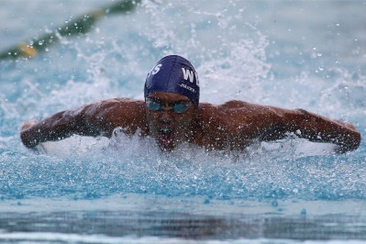
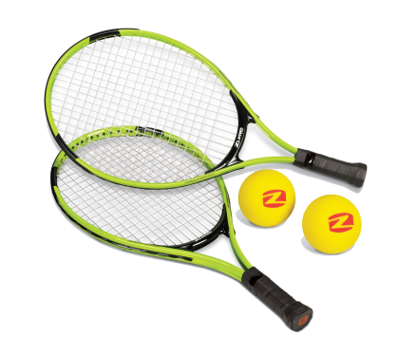
Question 8:
Is Mo Farah a champion at:
  Athletics?
  Football?
  Swimming?
  Or Tennis?

Slide 10
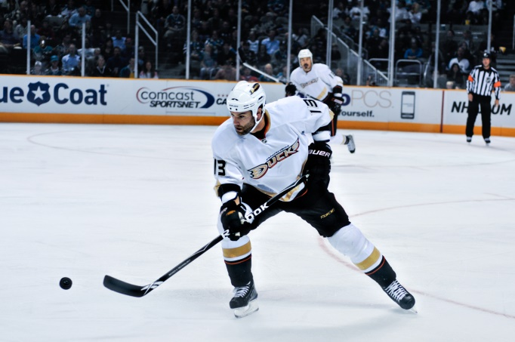
Question 9:
What sport is being played here?

Slide 11

Question 10:
A caddy is the person who carries a player’s bag in which sport?

Slide 12
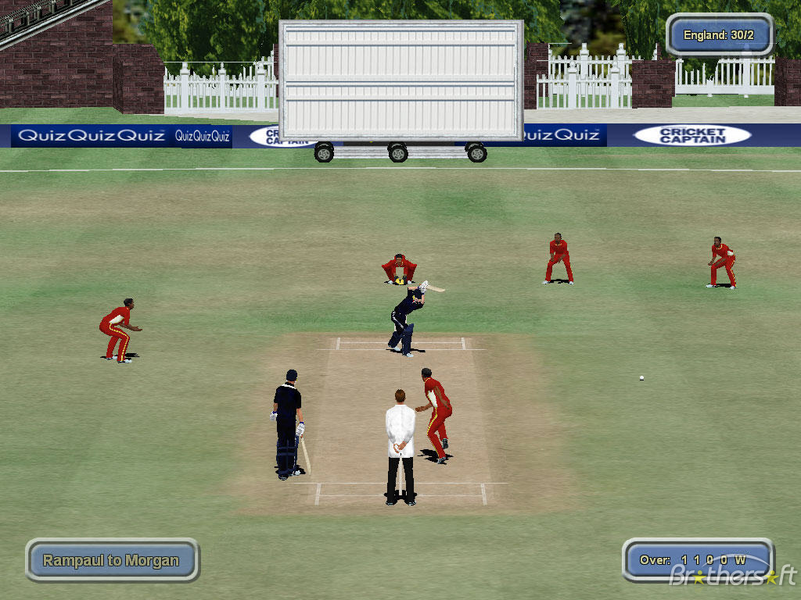
Question 11:
What sport is being played here?

Slide 13

Question 12:
How many goals are scored if a player has a hat-trick?

Slide 14

Question 13:
In which football stadium do Manchester United play all their home matches?

Slide 15

Question 14:
In the Olympics you get a gold medal for coming first, what do you get for coming second and third (two answers)?

Slide 16
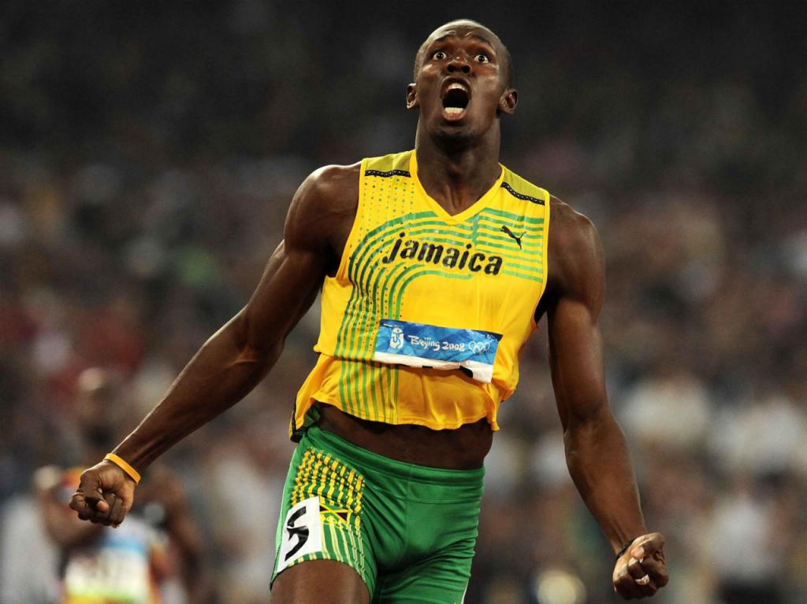
Question 15:
What sport is Usian Bolt associated with?

Slide 17

Question 16:
Andy Murray is a champion in which sport?

Slide 18
Question 17:
Which colours are on a chessboard?

Slide 19

Question 18:
What do teams pull in a game of tug of war?

Slide 20
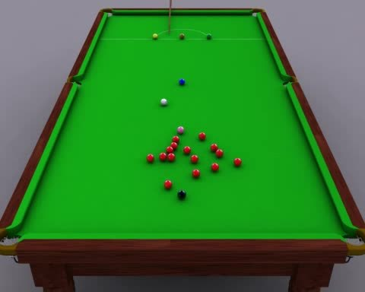
Question 19:
What colour balls are worth one point in a game of snooker?

Slide 21
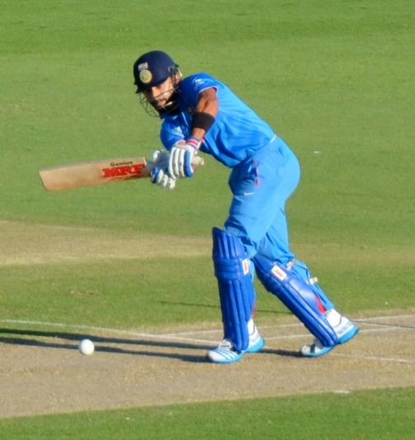
Question 20:
How many vertical wooden stumps make up a cricket wicket?

Slide 22
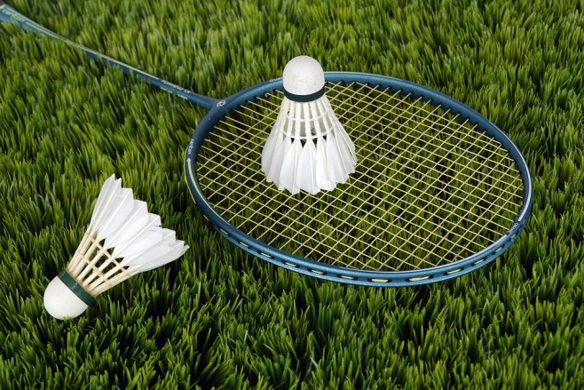
Question 21:
What sport uses this equipment?

Slide 23

Question 22:
What name is given to the spear like object thrown in athletics at the Olympics?

Slide 24

Question 23:
Which Country invented baseball?

Slide 25

Question 24:
Which football team are also called The Gunners?

Slide 26
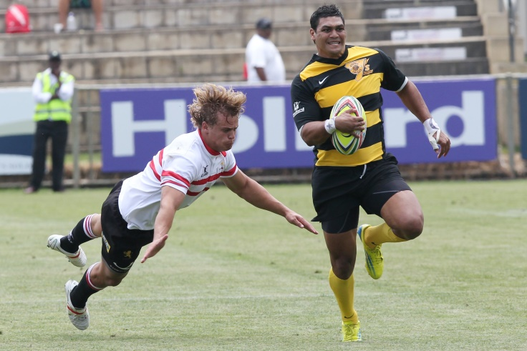
Question 25:
What sport is being played here?

Slide 27
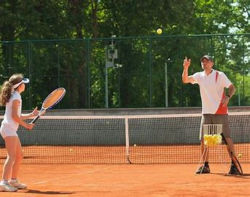
Question 26:
What sport is being played here?

Slide 28

Question 27:
In which sport can you get ‘a hole in one’?

Slide 29

Question 28:
Which sport is also known as ping pong?

Slide 30

Question 29:
In which athletics event do you jump into a sand pit?

Slide 31
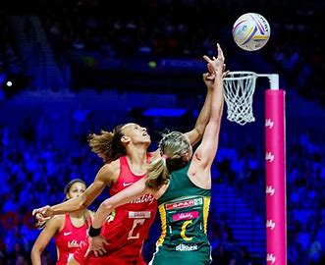
Question 30:
What sport is being played here?

Slide 32

ANSWERS:
11
Quiditch
Golf
Argentina
Five
Basketball
Butterfly
Athletics
Ice Hockey
Golf

Slide 33

ANSWERS:
11. Cricket
12. Three
13. Old Trafford
14. Silver (2nd) and Bronze (3rd)
15. Athletics
16. Tennis
17. Black & White
18. A long rope
19. Red balls
20. Three

Slide 34

ANSWERS:
21. Badminton
22. Javelin
23. USA
24. Arsenal
Rugby
Tennis
Golf
Table Tennis
Long Jump
Netball

Slide 35


How did you do?
How many correct answers did you achieve?
The maximum score is 31.
Work out your percentage:
Score divided by 31 = ??%
E.g. 20 / 31 = 65%
WELL DONE EVERYONE!

