Slide 1
PE Warm ups, activities & resources

Slide 2
PE Warm ups

Slide 3
Pac Man
Sidestepping using the lines on the playground. Pick 1 or 2 pupils to be on and capture the ‘pacmen.’ Once caught they are out- do simple star jumps, jogging, high knees to keep moving
Simon Says This could be teacher led or child led
Mirror Mirror
Stand opposite a partner or in a small group, copy the leader’s actions. Make sure you swap partners and roles

Slide 4
Tails Each pair should make a square or a circle with cones. Tuck a tail into shorts. Stand opposite each other and side step around the shape to catch the opposition’s tail while protection their own
On the whistle
Demonstrate that each whistle signals a different movement e.g 1 whistle= jog 2 whistles= jump 3 whistles = touch the ground
Gradually add/change the signals
Follow the leader In small groups behind each other follow and repeat the actions and directions of the person in the front. Swap and take turns

Slide 5
Pizza Toppings Start at one side of the playground. Choose a ‘chef’ who will catch the pizza toppings. When caught, the children also become chefs. Label children e.g cheese, tomato, pepperoni, ham. Shout a topping and children try to run from one side to another without being caught.
Dynamic Stretches
Mo bot (Side step making M) Zombies (straight arms with straight legs kicking to reach them, best zombie noises) Sumo squats (added sound effcts) Strictly Come Dancing (Grape vine with music) Lunges Can Can Open/Close the gate Heel Flick
Bean Game
Jumping Bean- jump up and down Runner bean- run around space Broad bean- stretch arms/legs as wide as possible
Jelly Bean- wobble like jelly
French Bean- Can Can
Bean Pie- Form a group Kidney Bean- bench and touch toes

Slide 6
Rats & Rabbits Children in pairs in the middle of the playground facing outwards. Label either rat or rabbit. If you shout ‘rabbit’ the rabbit must run in a straight line to a point. The rat must try and catch the rabbit before the end point.
Domes & Dishes Place domes and dishes (cones upside down) in the space. Allocate either dome or a dish to a child. Give time limit to turn the cones. Side with most wins. (Split into smaller groups if space allows)
Rock, paper, scissors Set out 3 zones. Split children into 2 groups leaving the middle zone free. Travel into the middle zone, meet a partner and do rock, paper, scissors and travel to the other side. When travelling think of a different way each time e.g hop, skip, jump, hopscotch, spin

Slide 7
No/Limited Equipment Socially distanced PE Activities

Slide 8
The Red Hot Letter Game Choose one person to be ‘on’ and decide on a ‘red hot letter’ e.g E Person who is on stands away from the group and faces away. They call out letters “Step forward if you have a W in your name.” The first player to reach the person who is on wins. If the red hot letter is called and someone steps forward by accident then they must go back to the beginning.
Funny Running:
The objective of funny running is to get from one side of the area to the other while moving like an animal. You can choose a different animal for each pass, including monkeys, snakes, horses, and kangaroos. Alternatively, you could put some music on and the children must move in time to the music. They could make up their own moves, do the floss, dabbing etc
Skipping Learn how to skip: 2 footed, moving, hopping, backwards Learn rhymes e.g Teddy Bear, Teddy Bear, girl guide dressed in blue
To practice jumping over, one child could stand in the middle with the others forming a circle around. Person in the middle swings the rope against the floor in a circle (Use soft rope) Wiggle the rope like a snake for children to jump over
Captain’s Coming: Captain’s coming: Stand in a line and salute
Scrub the deck: Pretend to scrub or do 10 push ups
Man the lifeboats: Sit ups and pretend to row the oars Port: Run to the left hand side Starboard: Run to the right hand side Jellyfish: Lay on backs with arms and legs in the air shaking
Climb the rope: Simulate actions for climbing rope

Slide 9
Splat Game Children make a circle 2m away with 1 person in the middle.
The player standing in the middle of the circle is the “splatter”. The splatter randomly points to someone and shouts “SPLAT!” The player pointed to must duck down; then the two players on either side of the “ducker” must “splat” each other by pointing to the other and saying “SPLAT!”
Popcorn Game Children standing 2m apart. They must shout ‘popcorn’ and jump up as if ‘popping,’ If more than one child shouts popcorn at the same time then they are out. Closing eyes is good for an added challenge.
Capture the Flag Split the group into two teams, each team having a flag or other marker at the team's base. The object of the game is to run into the other team's territory, capture their flag and make it safely back to your own territory. You can tag "enemy" players in your territory, sending them to your jail. They can be sprung from jail by a member of their own team running into your territory, tagging them and running back, with one freed person allowed per jail break. It is sometimes played that all the people in jail could hold hands and make a chain back toward their own territory, making it easier for members of their team to tag them.
King/Queen of the castle Create 2 castles or squares with cones or more if you have enough children. Choose a king or a queen to guard their castle. The aim is for everyone else to go through the castle without being ‘tagged.’ Variations: Use a ball and dribble ball with feet or hands through the castle. Use a point system

Slide 10
Four Square This ball game is played on a square court further divided into four smaller squares, numbered one through four. One player stands in each of the squares, with the highest ranked player in number one, lowest in number four. You bounce the ball among the players, bouncing once in the other person's square before that person catches it. The person in square one got to choose the rules. Anyone who violates the rules will have to move down in the ranking,
What’s the time Mr Wolf? One child is chosen to be Mr Wolf, who then stands at one end of the playing area. The other players stand in a line at the other end. Mr Wolf turns his back to commence play. The players call out, "What's the time Mr Wolf?" and Mr Wolf turns and answers with a time (i.e. 3 o'clock and take 3 steps forward).
Once the line of players is close to Mr Wolf, he can respond to the chant with "It's dinner time!" at which point, he will chase the players back to the starting line with the aim to catch one of the them, who will then become Mr Wolf for the next round of the game.
Hot Potato/Donkey Stand in a circle 2m away from each other. Throw the ball as if it’s a ‘hot potato’ burning your hands to another player. If the ball is dropped start spelling out the word ‘donkey.’ First drop= d, second drop= o and so on.
Duck, Duck, Goose All the players, except the first person who is It, sit in a circle. It walks around the circle, tapping each player on the head, saying “duck” each time until he decides to tap someone and say “goose.”
That person becomes the goose and runs after It, trying to tag him before It can take his seat. If It successfully reaches the goose’s seat without being tagged, the goose is the new It. Children can sit 2m away and clean hands.

Slide 11
Connect 4 Fitness Edition
Make 4 in a row by completing the activities. Your partner can block you by choosing to complete an activity themselves. See resources
Roll the Dice Display numbers 1-6 with an activity for each e.g 1= 5 star jumps 2= 10 second plank Roll the Dice Twice! First roll the dice to see what activity to do, then roll again to see how many times Competition time- split into groups. Which group will be able to complete activities 1-6 fastest. You will have to complete an activity if you roll the dice even if you have done it before. Keep going until all are done!
Netball rounders Divide children into 2 teams (one is the running team and one is the shooting team. Groups should be socially distanced) Running team have to run around the court back to the beginning until the player in the shooting team scores. Once they score the runner freezes. The last runner can collect the frozen players on their team (so the best shooter usually goes last)
Target Throw Children use their own bean bags to throw into hoops. Experiment with overarm/underarm throws. Can children adapt the game and make their own rules. E.g points Use chalk to draw colours/targets on a wall and practise chest passing/shoulder passing.

Slide 12
Cone Dance Mat Children stand in the middle with 4 different cones 1 in front, behind and left and right. Shout a sequence of colours which children will have to remember and move to. You could specify jumping or with a certain foot to make it harder. Play with music for even more fun!
Cone Mapping Give pairs 4 sets of 3 coloured cones e.g 3 blue, 3 red, 3 white, 3 yellow Set the cones out in rows of their colours. For social distancing one child could be reading instructions 2m away. Cones worth a number of points. Child reads instructions to move a certain route. See examples in the resource section from British Orienteering.
Colour Run Grab 4 different coloured objects and place them in a square shape (the smaller the square the easier it is)
Stand in the middle of the square and have someone call out a colour and run to the colour. This could be individual. Variations:
Add more colours
make the square larger
Play with more people in the middle
Give instructions how to get to the colour (e.g Red Hopping, Green jumping, Yellow rolling)
Obstacle Course Create an obstacle course where children don’t need to touch anything or they could use own bean bags etc. Use hurdles, spots, hoops.

Slide 13
Skittles Children set out skittles/old bottles/cones and roll a ball to knock them over. Children can use their own ball and 1 child could put up the skittles to avoid cross contamination.
Bring Sally up, Bring Sally Down This could be done with squats, push ups or sit ups. Move in time with the song. Push up ‘bring sally up’ bring down ‘bring sally down etc’
Scavenger Hunt See how many of these items you can find? A 'Y' Shaped stick/twig, a perfectly round pebble, a penny, a stick longer than your arm, something blue, a flower, a leaf with 3 points or more, a red leaf, something bigger than your hand, a ball, something square
Fitness Monopoly Work your way around the board and complete the activity on the square you land on. Try and make your way round the board as many times as you can. You could set a target, maybe first to 10 points wins! There aren't any houses or hotels in this game but you could always play the real version and then add in these moves for the places if you wanted! See the Monopoly Board in the resources section

Slide 14
The Name of the Game Spell your name and complete the corresponding fitness moves. You could spell your whole name, favourite colour etc for a bigger challenge See resource section for example
Cone Run Set out cones in colours in rows along the playground so the playground is divided into sections. The aim is to shout a colour and the children will hop, sidestep, jump, run to that line of colours. You could call out a combination of colours to make it harder.
Battleships Players have three objects (e.g cones) which are their battleships. Take it in turns to throw a ball or bean bag to hit opponent’s battleships. Players cannot defend their own battleships. Variations: Defending Throwing with weaker arm Ultimate battleship, if hit can add back in one of own.
Fitness Challenge Time for 1 minute doing each of these exercises. How many reps can the children get?
1. Burpees
2. Squats
3.Push ups
4. Sit ups
5. Mountain climbers
Then, repeat the circuit 2 more times. The aim is to beat their personal score each time.

Slide 15
Standing Long Jump Jumping from a marker, bend knees and swing arms to give child momentum. Mark a cone from the heel of their back foot. Can this distance be beaten? Keep practising Aim to land on feet and stay balanced
Triple Jump Practise hopping first (1 foot to the same foot) Practise the ‘skip’ step (one foot to the other foot) Practice the jump step (one foot to two feet) Build the steps up in a sequence. Hop Hop and skip Hop, skip and jump After practice, mark out the distance and try and beat it!
Hurdles Set out hurdles a safe distance from each other. To allow enough space in between. To get children used to the idea of going over the hurdles, practise running and doing a 2 footed jump first. Demonstrate how to lead with one leg and bring the other one round and over. Let children run and practise using both legs as leading legs and decide which is most comfortable for them. Hurdle relays and races.
How many jumps? How many jumps will it take to reach a destination like the end of the playground? Try different jumps, squat jumps, skips, hops, leaps, What do you predict will be the least amount of jumps and why? Did the prediction meet the outcome?

Slide 16
Vertical Jump
The participant stands with their back and heels touching the wall. Both arms should be stretched upwards and legs straight. Turn side on, move 20cm away from the wall, jump and touch the scale at the highest point. Record the number reached and calculate the difference between stretched height and jumped height. Children could mark where they jump to with a bit of chalk, a printed scale could also be used.
Rope Jump Use a long rope with one person holding at each end. Set a height for children to jump over, the height could be increased or decreased for each child. Experiment with different jumps, forward, sideways, one footed, two footed etc
PE Ladder/ Hopscotch
Draw a ladder or hopsotch on the playground or use an agility ladder/playground markings. Find different ways of jumping/hopping. 2 feet to 1 footed 1 foot to another 1 foot to 2 feet Forwards, backwards, turning, frog jumps
Speed Bounce Either alone or with a partner and swapping. Use a low hurdle, small cone or another low object. Try and jump side to side over the object as many times in a set amount of time. Gradually build up e.g 30 secs, rest , 45 seconds, rest, 60 seconds

Slide 17
Shuttle Run
Set up a distance marked at either end using cones or an alternative mark (pegs, tape, tins etc…) to create the running lane and children run back and forth set amount of times. Could be done in teams but also with own running lanes for social distancing depending on amount of children and space. Each participant runs the 5m distance a total of 20 times to complete 100m. Alternate who is running on the team. A handheld stopwatch or smart phone stopwatch can be used to record the time
Suicide Runs
Using playground markings start on a base line, run to the nearest line and back, run to the next line and back and so on until the end.
Catch me if you can
Split children in 2 groups and position the groups opposite from each other on a track. The aim is to run as a group and not get caught by the other group. The first group to catch up with the other wins!
Increased runs Start by running/jogging for 30 seconds then walk or slow jog for 30 seconds and repeat Run/jog for 45 seconds then walk or slow jog for 45 seconds and repeat Run/jog for 1 minute then walk or slow jog for 1 minute and repeat Run/jog for 2 minutes then walk or slow jog for 2 minutes and repeat. For more of a challenge reduce the rest time.

Slide 18
Throwing and catching Children could throw a ball against and wall and catch or they could throw the ball up in the air and catch. Practise throwing/catching with 2 hands, 2 to 1, right hand to right hand, left hand to left hand, right hand to left etc. Can children throw the ball and clap, how many times? Can they lay down whilst throwing and catching accurately? Can children create their own routines? Use different sized balls: tennis balls, ping pong balls, soft balls, netballs
Shot Put Teach the shot put technique. Children could use shot puts or for younger years use tennis balls. Teaching points: Hold shot put at the side of the neck using the fingers Bend to one side keeping chin, knee, toe in line Arm pointing forward Come up and twist forwards Push shot put forwards and release at highest point.
Javelin Each child could have their own javelin, spread at least 2m away from each other. Only collect when instructed to do so. Teaching Points: Stand with feet making 90 degree angle arm bent and elbow forward Front foot should be pointing in the direction of throw with arm that is not throwing used as a pointer. Throw the javelin forward, be careful not to ‘flick the wrist’ as this will cause the javelin to rotate forwards and it will be disqualified
How many throws? Using bean bags, quoits, air flow balls etc throw the object across the playground. How many times will it take you to get across the whole thing? Experiment with different objects and compare which is the best to use and why

Slide 19
Triangle passes Played with 2 children, set out a triangle shape with cones. Children stand on 2 of those with a ball, Person throws the ball towards the free cone so the other player has to move towards it. This could be done throwing, kicking or using hockey sticks.
Bounce Passes Set up targets e.g cones, spot or hoops. Aim to bounce the ball to knock over the cone or to bounce within the spot or hoop. This could be done with a partner on the other side. Teaching Points Feet should width apart, ball in hands making a ‘W’ shape. Tuck elbows in and push ball forward aim to bounce ¾ of the way between you and partner.
Cut the cake Make a circle with one player in the middle. Person on the outside starts with the ball and passes into the middle. This person should follow the ball and take the place of the person in the middle while that person throws the ball back out to the next person in the circle. Continue throwing and following the ball.
Ball Skills Working with a partner, practise different type of throws to keep the receiver on their toes. Drop ball- can the receiver catch it with the least amount of bounces Chest pass Shoulder pass- use both sides to get the receiver practising catches each way. Bounce pass

Slide 20
Dribbling with a football Practise dribbling in and out of cones using different techniques. Make it easier by spreading cones further apart Teaching points Encourage head up and not looking at the ball Experiment with dribbling with just the inside, just the outside, using both, using one foot, both feet, weaker foot etc
Defend the target Depending on how many children set up targets or ‘goals’ around the area with cones. Have a child to defend their goal. Other children will aim to pass ball through the goal, which could score a point. They could also dribble ball through the goal keeping control of the ball. Set out a big enough goal to ensure enough space to go through. The children might recognise that they could pass ball through when the defender is distracted with another player.
King of the Ring with a football Each player has a ball they must keep control of but the aim is to knock another player’s ball out of play whilst looking after their own. If the ball gets knocked out then that player could leave the ‘ring’ and play continues until there is a king. To keep all children active, continue play after ball is knocked out and children keep a tally of how many balls they have knocked out.
Clean the room Separate 2 teams or groups with a divider line in between. Give balls to each team. The aim is to kick balls into the opposition’s half and be the team to have the least amount of balls on their own side. Teaching Points Look up, think where you are kicking the ball to, not at anybody. Use the inside of the foot (flat bit) to keep control and accuracy. (also known as a push pass)

Slide 21
Jail Children line up at one end of the court. Feed from the opposite side of the net. Each child gets a certain number of chances to get a forehand or backhand into the court. If they gets one in they are safe. If not, they go to jail (the other end of the court where they will try to catch a ball hit by another player) If they makes her catch, she is free from jail and can rejoin the line , and the player she caught goes to jail.
Around the World Split the group into 2 with a net in the middle. Initially start with a tennis ball, throw the ball over the net to the person opposite, who will try and catch it with only one bounce. The person who threw the ball must follow the ball and run to the opposite team. When children are confident, add in racket and try and build up a rally between the sides.
Floor Tennis Children 2m apart with 2 cones either side ‘goal.’ Using a racket and a ball, push the ball along the ground to a partner. Build up a rally with your partner and then a scoring system could be introduced. E.g 1 point for scoring between the cones and 2 points for hitting the cones.
Squares Set up a square in cones (the bigger the square, the easier it is). Children to work in partners and hit the ball into the square, their partner must return the ball into the square and so on to build up a rally. Children can move around the square. They could invent their own game by adding in points or additional rules.

Slide 22
Jail Break Split into 2 teams 1 v 1 rally with net in the middle, if you lose the rally then you must sit on the side with the racket in front of your face like a jail. On the next 1 v 1 rally, if the jailed player’s team mate wins, they can be freed from the jail.
Pat or Catch Children in s line with a ball. Teacher to shout ‘pat’ or ‘catch.’ Children either catch the ball or pat it back to the teacher and return to the end of the line. Put into smaller groups for more play time or children become the instructors too.
Tidy Bedrooms Objects placed on one side of the net with the aim of children hitting the tennis ball on one of the objects. If they hit the object they must shout ‘tidy bedroom’ and they can go and collect the object. The winner is the child with the most objects.
Catch Ball One person stands on the opposite side of the net without a racket. The rest of the group 1 by 1 has to hit the ball over the net and the other person has to try and catch it. If the ball is caught then the person who hit it over also becomes a catcher. The winner is the last person hitting the ball.

Slide 23
Cross the river Children must cross from one side of the playground to the other whilst jumping over balls that are being rolled along the floor. The aim is to not get hit by one. For added challenge add obstacles in the river or stepping stones to cross on (spots). There could be a consequence of being hit.
Dribbling Using the tennis racket, children can dribble round the cones in a variety of ways: -Dribble the ball on the floor with racket pushing -Keep ball on racket whilst travelling in and out of cones
-Bounce ball on racket whilst travelling in and out of cones -Bounce ball on the floor using the racket whilst travelling in and out of cones.
Ball Skills How many times can you bounce the ball on the racket without dropping it? How many times can you bounce the ball on the floor using the racket? Can you sit down, lay down and stand back up still bouncing the ball on the racket and do the same for bouncing on the floor?
King/Queen of the court The other players make a line behind the baseline of the current side. One challenger steps up and plays a singles point against the ‘King or Queen.’ If the king or queen is beaten then the challenger takes their place. If the King or Queen wins the point they remain. The winner is the person who is King or Queen at the end of the time.

Slide 24
Resources

Slide 25
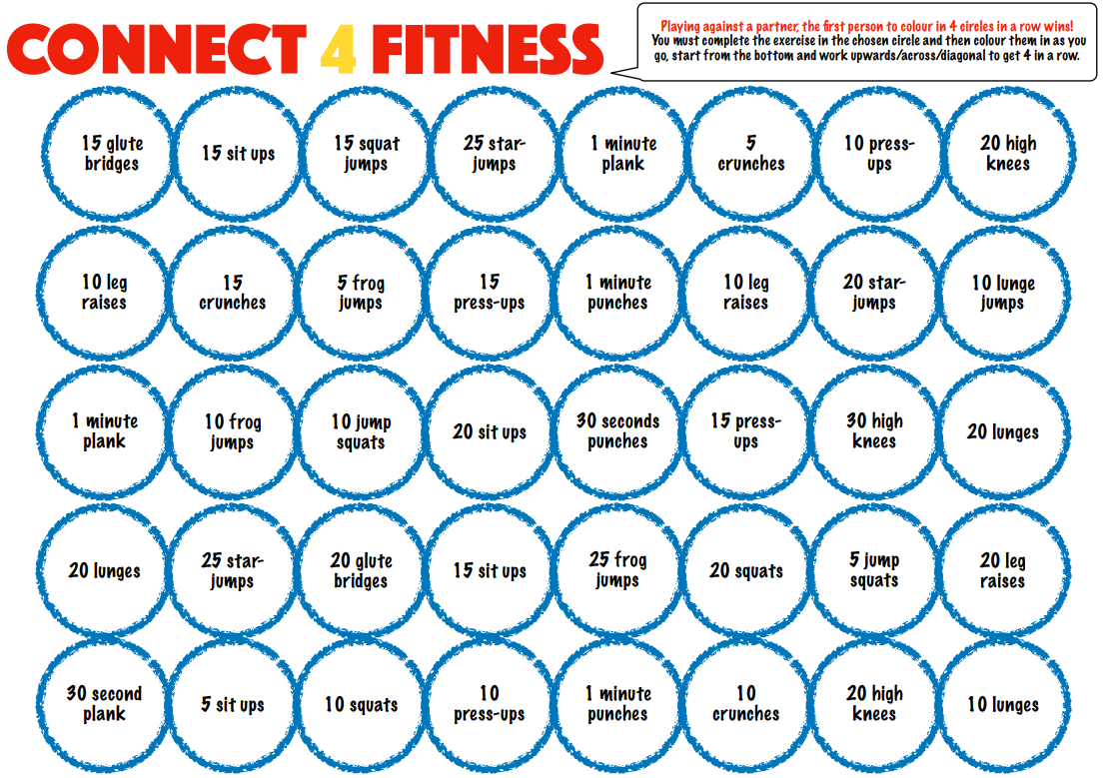

Slide 27
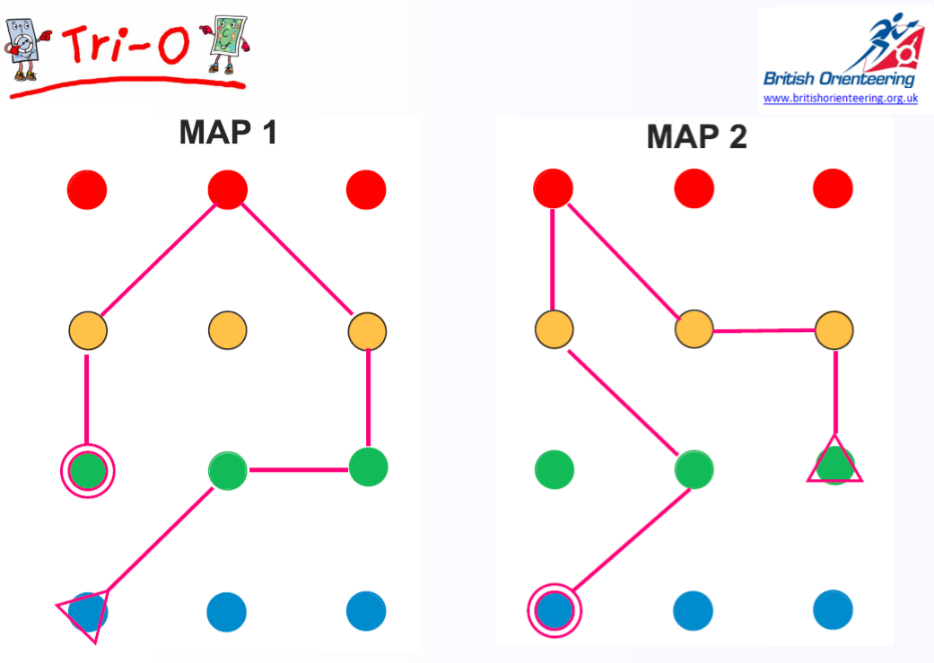

Slide 28
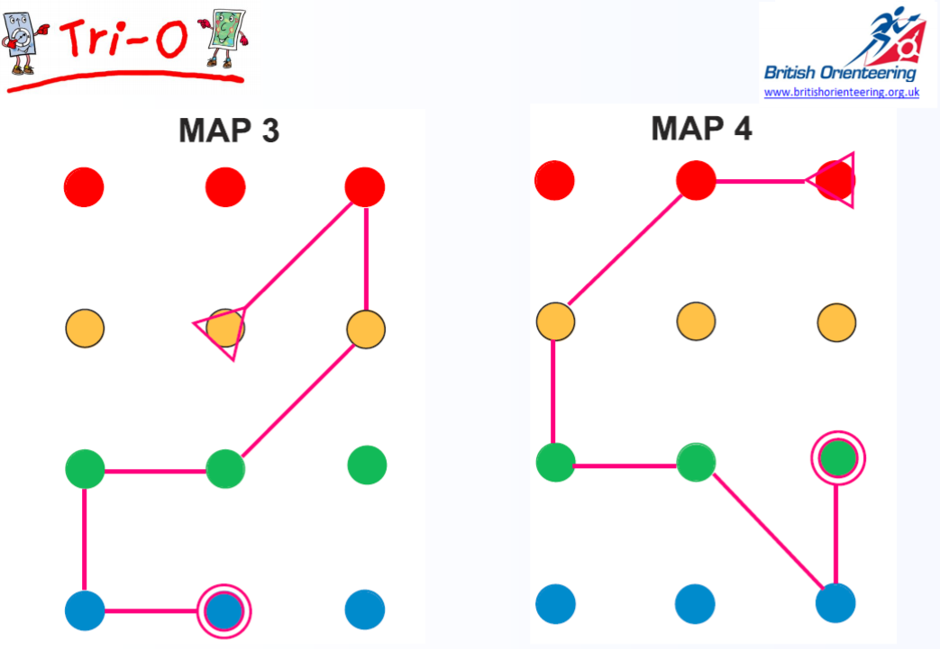

Slide 29
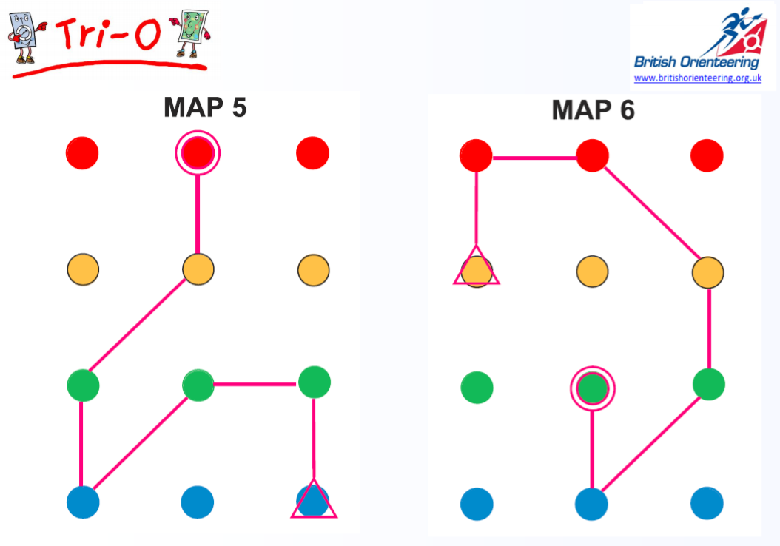

Slide 31
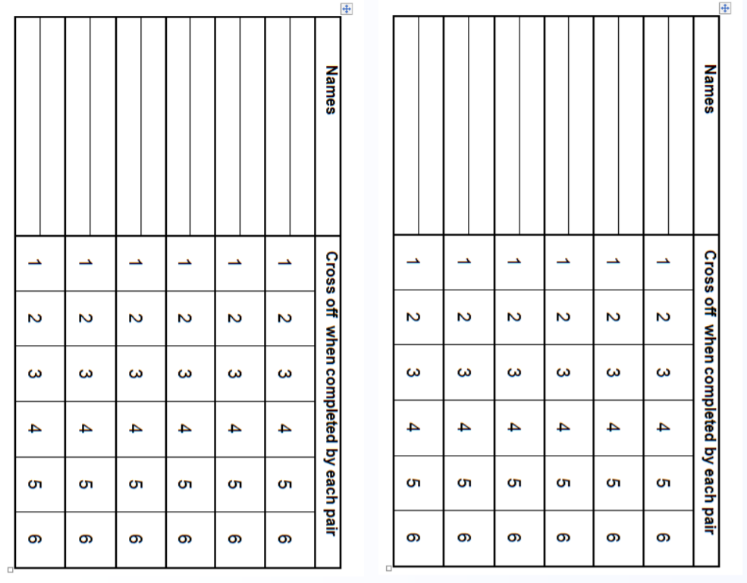

Slide 32
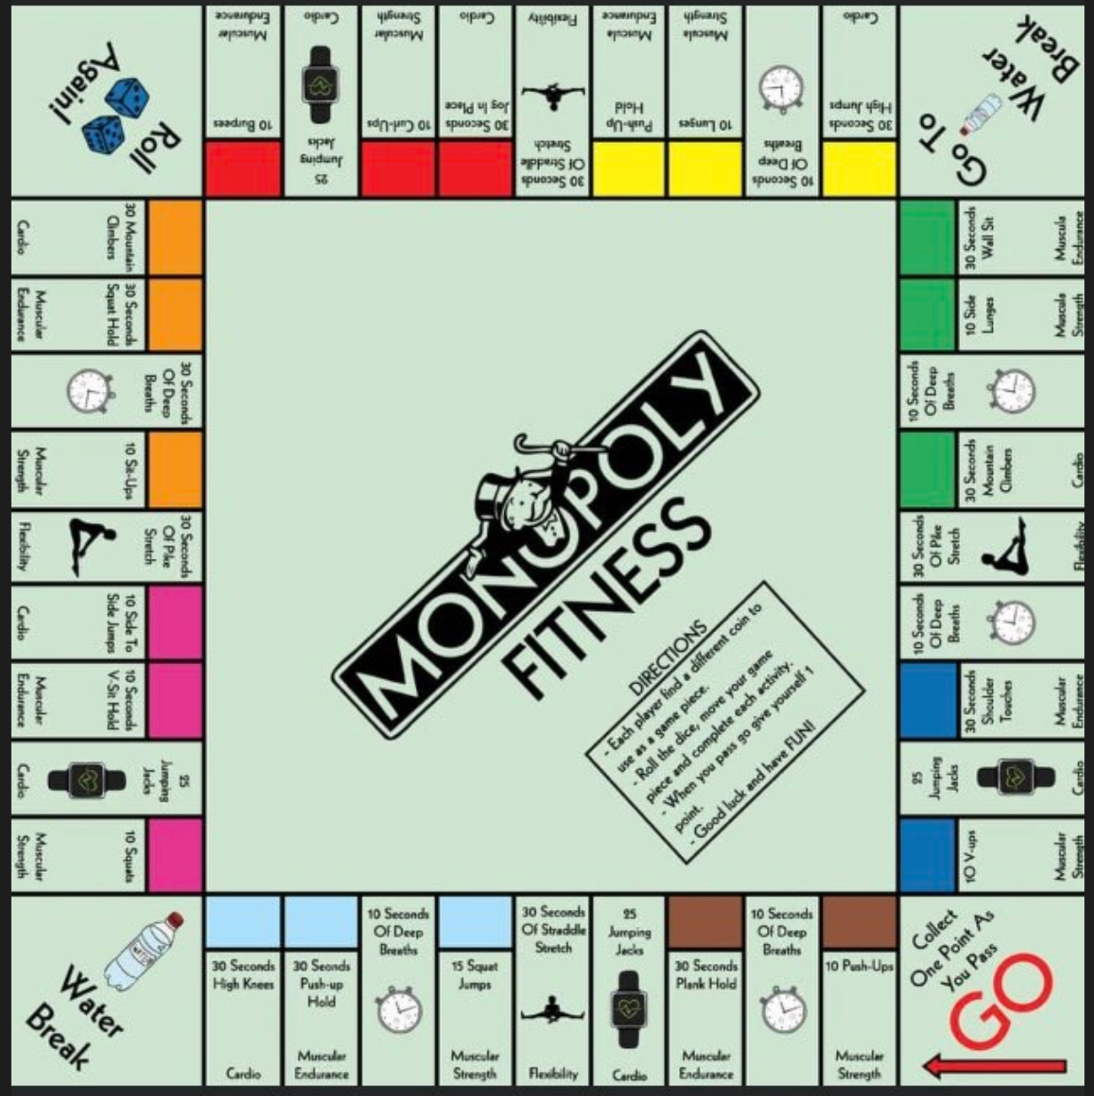

Slide 33
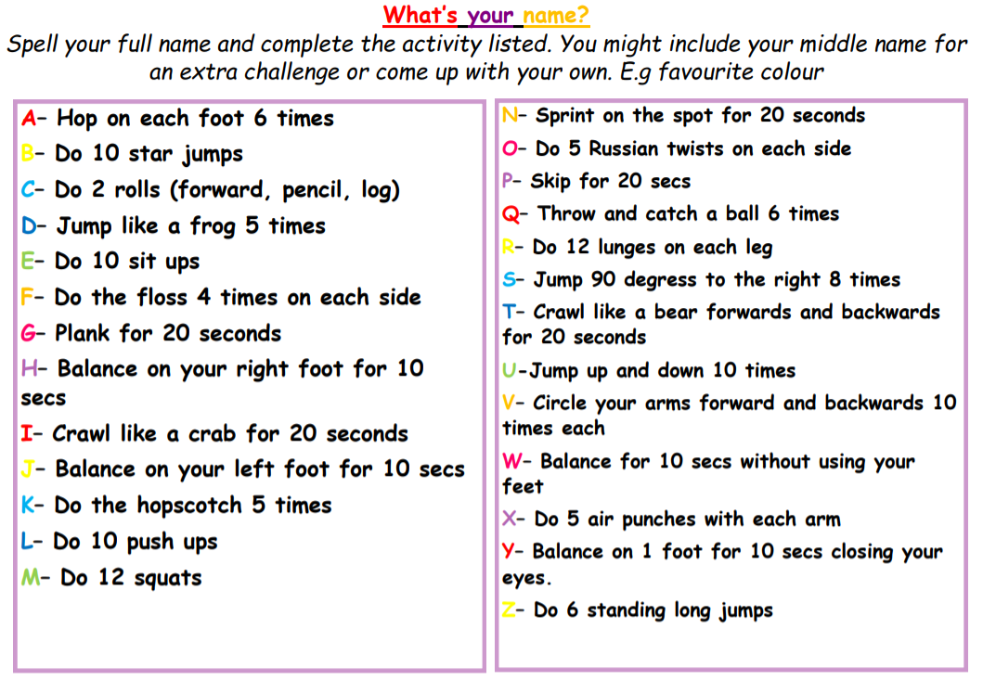

Slide 34
Active Months

Slide 35
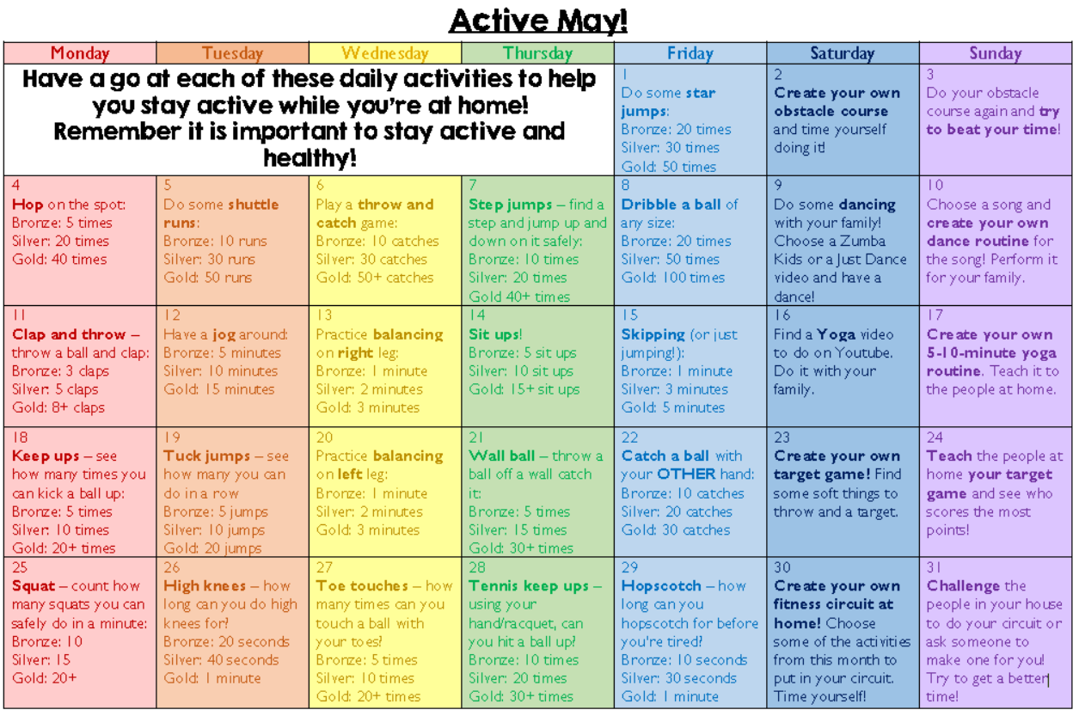
ACTIVE JUNE!

Slide 36
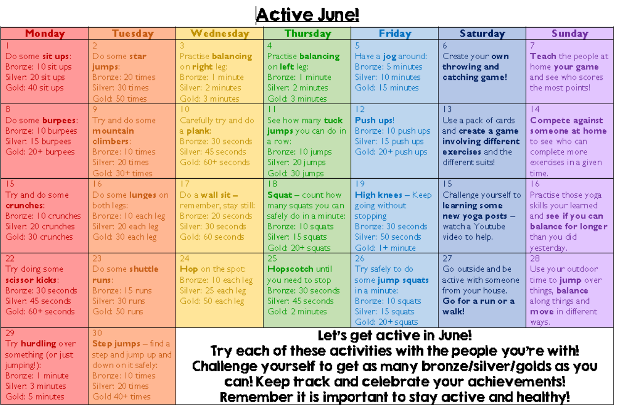
ACTIVE JULY!
Let’s get active in July!
Try each of these activities with the people you’re with!
Challenge yourself to get as many bronze/silver/gold as you can! Keep track and celebrate your achievements!
Remember it is important to stay active and healthy!

